Slide 1
Class 5

Slide 2
https://www.youtube.com/watch?v=L-K19rVDxoM (Skip US politics)

Slide 3
Everyone has a slip of paper…
Papers are designed to fit into groups of 3.
Travel the classroom until you find your group of 3.
Sit down together and be prepared to describe the LINK between you to the class.
Also be prepared to briefly explain your slip to the class.
If you don’t know what your slip of paper means look it up in your notes asap or ask me for help.

Slide 4
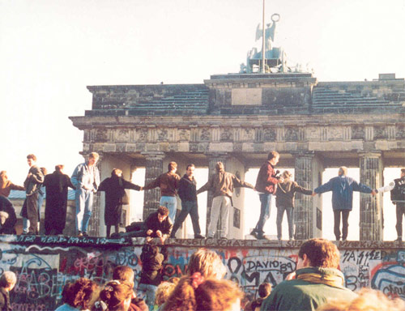

Slide 5
Détente
“A relaxation of tension”
Used to describe Soviet-American relations from after the Cuban Missile Crisis (1961) Until the First Afghanistan War (1979).
It appeared Détente could end the war but in fact things “heated up” until the Soviet collapse.

Slide 6
Problems with the Soviet Union
Real Communism (Marx and Engels) stated that the government should control everything so that everyone could be equal. Aka no poverty, no excess wealth and no discrimination.
The USSR version of Communism never came close to achieving this standard.
Therefore it was a failure and many problems Russia and the former soviet republics face today can be traced back to this failure.
Armenia, Azerbaijan, Belarus, Estonia, Georgia, Kazakhstan, Kyrgyzstan, Latvia, Lithuania, Moldova, Russia, Tajikistan, Turkmenistan, Ukraine, and Uzbekistan.

Slide 7
Reasons the Soviet Economy Failed:
Real Communism (Marx and Engels) | USSR Version of Communism
1) State (government) controls the economy to “plan” what is needed for production and consumption. 2) Annual economic growth is encouraged by motivation because everyone works for themselves (everyone is equal and shares in the benefits). 3) There is no corruption because everyone is on the same playing field. | 1) Government plans poorly and resources are wasted. Result: not enough important goods (food, clothing etc.) too many weapons, missiles, exports. 2) Economic growth becomes negative because classes exist: Rich elite, middle class, poor. 3) Corruption is high because moral and happiness are low (low standard of living, “West” looks and sounds much better (freedom).

Slide 8
Social Problems in the USSR
Military Spending varied between 15-25% of GDP vs US 5-7%.
Inequality was widespread especially between the privileged members of the communist party (opposite of communism). Think George Orwell was right??
Ideology: Communism had been Russia’s policy since 1917. By the 1970s few believed that the positive changes could still occur. Patience was over.
Nationalism: Fully 50% of the population of the USSR was not ethnically Russian. The “Former Soviet Republics” craved independence and a voice for the people.

Slide 9
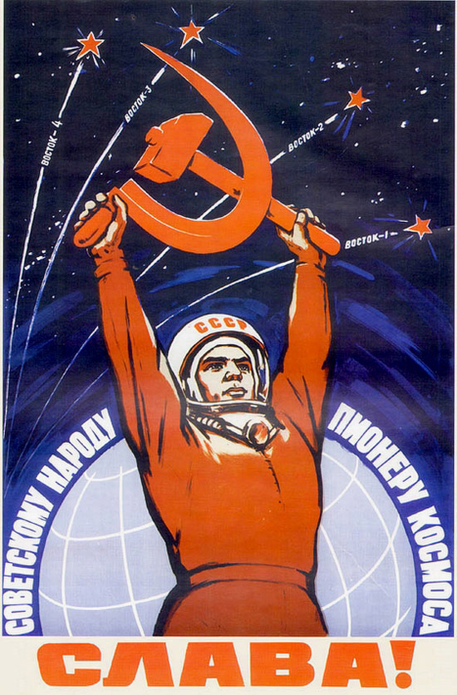
“The Space Race”
Space exploration served as another dramatic arena for Cold War competition.
In 1957, a Soviet intercontinental ballistic missile launched Sputnik, the world’s first artificial satellite and the first man-made object to be placed into the Earth’s orbit.
Sputnik’s launch came as a surprise, and not a pleasant one, to most Americans. In the United States, space was seen as the next frontier, and it was crucial not to lose too much ground to the Soviets

Slide 10
Sputnik #2 “Laika”

Slide 11
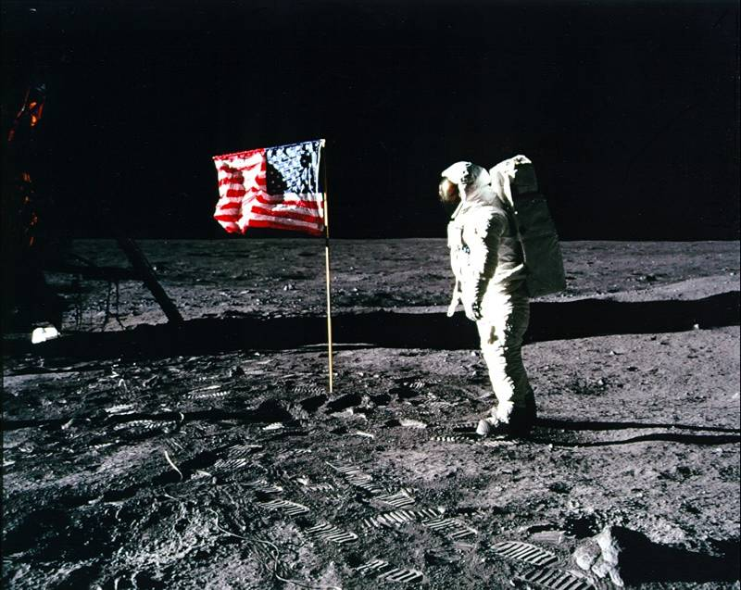
“The Space Race”
On July 16, 1969, U.S. astronauts Neil Armstrong, Edwin Aldrin and Michael Collins set off on the Apollo 11 space mission. Armstrong became the first man to walk on the moon’s surface; he famously called the moment “one small step for man, one giant leap for mankind.”
By landing on the moon, the United States effectively “won” the space race that had begun with Sputnik’s launch in 1957.
But who spent more? At what social cost?

Slide 12
TEST: FRIDAY
July 26th

Slide 13
Class 6

Slide 14
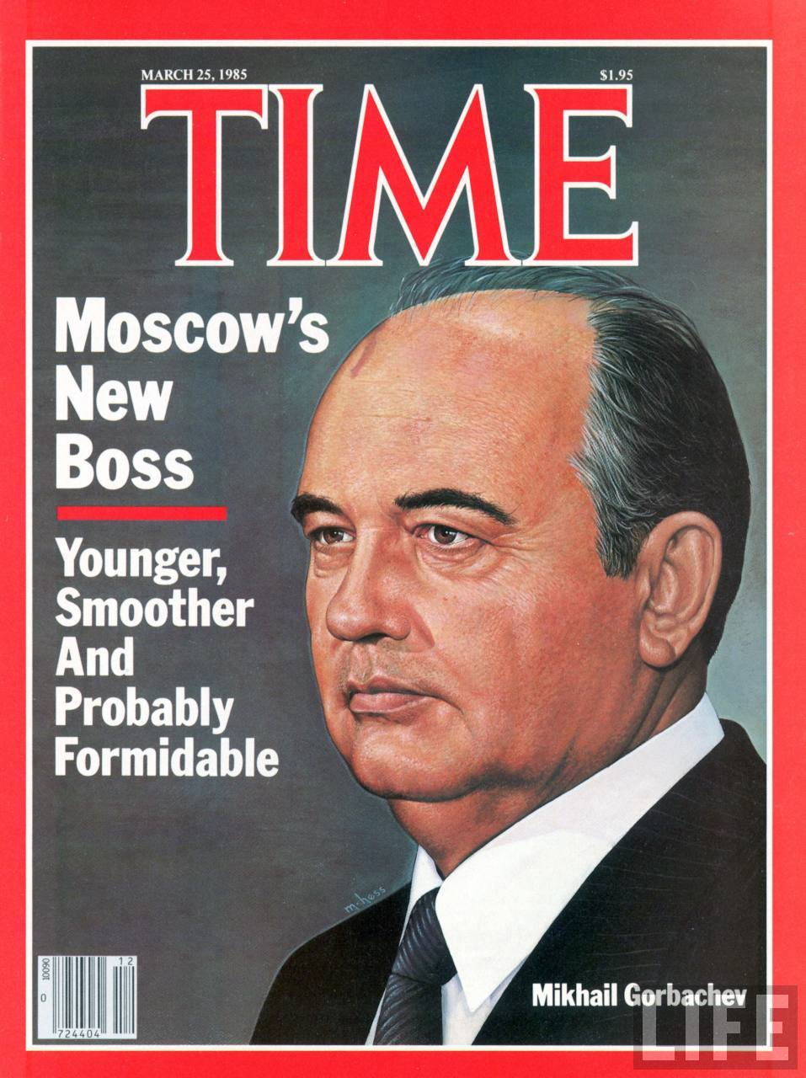
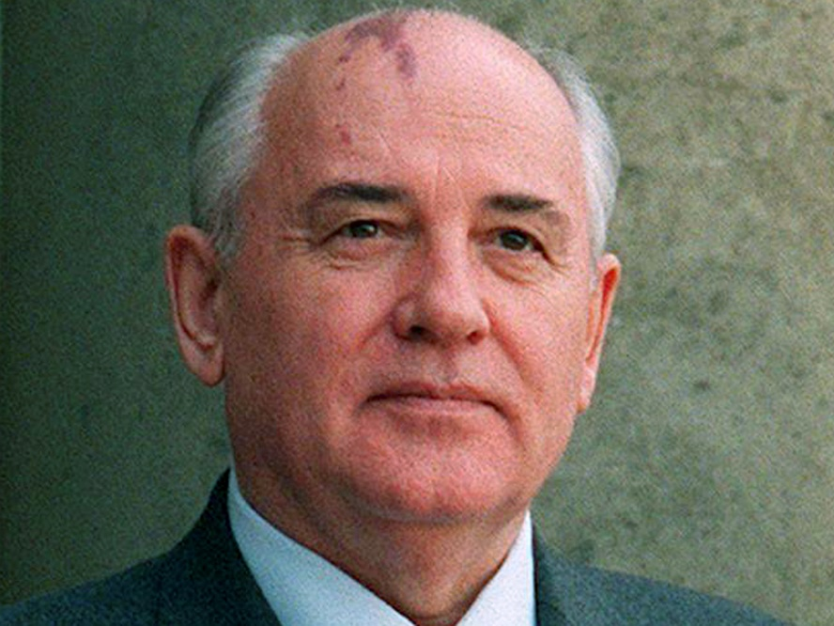
The Politics Behind The Collapse of the USSR
Mikael Gorbachev became leader of the Soviet Union in march 1985.
He immediately set about fixing the economic and social issues of the USSR.
Attempt #1 – Glasnost
Attempt #2 – Perestroika

Slide 15
The Politics Behind The Collapse of the USSR
Attempt #1 – Glasnost. Literally “Openness.” In other words people can express their opinions without fearing jail.
Attempt #2 – Perestroika
Literally “Restructuring.” Economic and Social Reform.

Slide 16
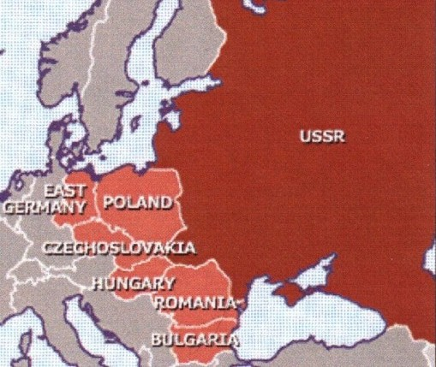
The Politics Behind The Collapse of the USSR
- Protest and revolution spread in the satellite states: Poland, Ukraine, Bulgaria, Czechoslovakia, East Germany, Romania, Yugoslavia broke away from Communism.

Slide 17
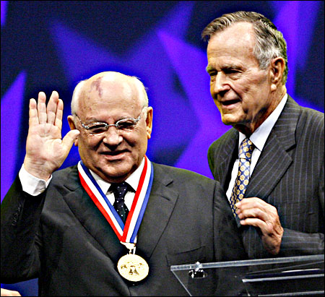
The Politics Behind The Collapse of the USSR
1990 Nobel Peace Prize Winner?
Gorbachev wanted to Reform the USSR not collapse it. However his “Reforms” occurred to rapidly. Once the people tasted freedom they jumped on board a Revolution

Slide 18
The Politics Behind The Collapse of the USSR
In Russia Boris Yeltsin led a coup d'état (overthrow) and in 1991 the USSR official dissolved into 15 new States.

Slide 19
http://www.dailymotion.com/video/x1ee465_copy-of-simpsons-soviet-union_fun

Slide 20
Today’s Assignment:
Counterpoints Textbook
Read pages 136-139
Answer Questions
2, 3 a & b, 5

Slide 21
Exit Slip:
Consider the insane amounts of $$ spent on the cold war.
Nuclear weapons, space race, spying, anti-terrorism, wars…
Was this money well spent? Did the 2 power system actually create world peace? What could this money have been best spent on?

Slide 22
How Should Canada Spend its GDP?
Gross Domestic Product (GDP) Leaders 2015
USA | 1 | United States | $ 18,036,648,000,000
CHN | 2 | China | $ 11,007,721 Million
JPN | 3 | Japan | $ 4,383,076 Million
DEU | 4 | Germany | $ 3,363,447 Million
GBR | 5 | United Kingdom | $ 2,858,003 Million
FRA | 6 | France | $ 2,418,836 Million
IND | 7 | India | $ 2,095,398 Million
ITA | 8 | Italy | $ 1,821,497 Million
BRA | 9 | Brazil | $ 1,774,725 Million
CAN | 10 | Canada | $ 1,550,537Million
KOR | 11 | Korea, Rep. | $ 1,377,873 Million
AUS | 12 | Australia | $ 1,339,141 Million
RUS | 13 | Russian Federation | $ 1,331,208 Million

Slide 23
 | 2019
1 | United States 21.34
2 | China, People's Republic of 14.22
3 | Japan 5.18
4 | Germany 3.96
5 | India 2.97
6 | United Kingdom 2.83
7 | France 2.76
8 | Italy 2.03
9 | Brazil 1.96
10 | Canada 1.74
11 | Korea, Republic of 1.66
12 | Russian Federation 1.61
13 | Spain 1.43
14 | Australia 1.42
15 | Mexico 1.24
16 | Indonesia 1.1
https://www.imf.org/external/datamapper/NGDPD@WEO/OEMDC/ADVEC/WEOWORLD

Slide 24
How Should Canada Spend its GDP?
If Canada has the spending power of 1.7 Trillion, how should we spend it?
Your task is to make a budget for the top 5 things we should spend our money on.
Include a 2-3 sentence explanation for each choice.
Ex: 1. Weekly National Beer drinking day
2. Paying Women at Fifa World Cup
3. Developing a better soccer team
4. A new breed of superhumans
5. Zombie eradication programs

Slide 25
Find another pair or group of 3 an make a “super” list of the “best 5”
Record your choices on the paper provided.
Prepare to present your ideas and 2 – 3 sentence explanation per item.
Answer: Why is this issue a justified part of this list?

Slide 26
Exit Slip Assignment
Answer the following question in paragraph form:
Underline the THESIS (your main argument) statement – 1 sentence.
1) Evaluate the following statement, explain why you agree or disagree using evidence from the lesson to back up your selection:
“ Vietnam would be a peaceful, democratic country
today if the United States never interfered in 1954.”

Slide 27
Exit Slip:
In a 7-10 sentence paragraph state your stance on the following issue:
Having 2 Equal Powers (the Soviet Union and the United States) actually encouraged world peace. Therefore, the money spent on the Cold War was not misplaced and was justified. Do you agree or disagree, why or why not? Provide 3 examples to back up your argument.

Slide 28
Protecting Canadian Culture
By 1950’s American culture began flooding into Canada
1951 Massy Commission reported that Canadian culture was at risk and recommended strong support for Canadian culture agencies like the National Film Board (NFB) be strengthened and the CBC be put in charge of the development of Canadian television.

Slide 29
Protecting Canadian Culture
In 1968 the Canadian government created the Canadian Radio-Television Commission
The CRTC was given the job of controlling television licensing, and made sure that radio and TV stations broadcast specific percentages of Canadian content
Its responsibilities now include all tele-communication and media in Canada

Slide 30
Postwar Canada Prime Ministers
PM Laurant (1948-1957) LIB
PM John Diefenbaker (1957-1963) CONS
PM Lester Pearson (1963-1968) LIB
PM Pierre Trudeau (1968-1979,1980-1984)LIB -Joe Clarke
PM Brian Mulroney (1984-1993) CONS
PM Kim Campbell (1993) CONS
PM Jean Chretien (1993-2003) LIB
PM Paul Martin (2003-2006) LIB -Because JC resigned
PM Stephen Harper (2006 - 2015) CONS
PM Justin Trudeau (2016 - ?) LIB

Slide 31
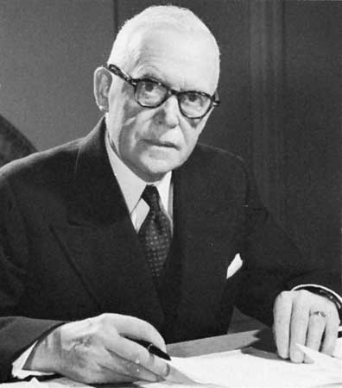
PM Laurant LIBERAL
Mega projects such as the trans Canada Highway, the St. Lawrence Seaway, and the Trans Canada Pipe-line

Slide 32
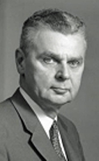
PM Diefenbaker CONS
Cancelled the controversial Avro Arrow project in 1959 when Canada was at the forefront of science and technology
Believed in an unhyphenated Canadianism
1st PM to include women in his cabinet
Gave Status Indians the right to vote in federal elections
Introduced the Canadian Bill of Rights, 1960

Slide 33
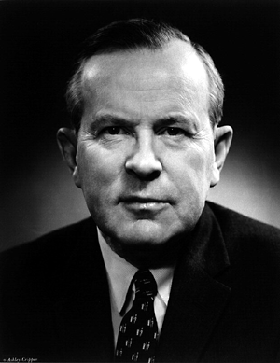
PM Pearson
Abolished capital punishment
Introduced the Canada pension plan, 1966
Medicare Act, 1966
Best remembered for Canada’s new flag
Nobel Peace Prize recipient

Slide 34
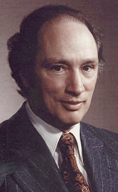
PM Trudeau
Believed in a “just society”
1969 introduce the Official languages Act-gave Canadians the right to deal with the governments or courts in French or English
1982 repatriated Canada’s Constitution. The Canadian Charter of Rights and Freedoms became a part of the Canada Act
In power when Quebec passed Bill 101 (1976) restricting the use of the English language in Quebec
Repatriated the Canadian Constitution in 1982 without the support of Quebec

Slide 35
Trudeau’s Foreign Policy
Created a foreign policy less dependent on the US
As a middle power, Trudeau aimed to bridge the gap between west/east (communism vs. capitalism) & north/south (rich vs poor) countries
Canadian International Development Agency (CIDA): created in 1968 under Trudeau’s gov’t
Tied-Aid: Objective was to boost foreign aid to less industrialized countries. Countries would have to agree to buy products manufactured in Canada

Slide 36
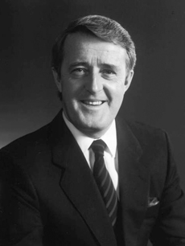
The Mulroney Era
Closer ties to the United States
In 1988 signed the North America Free Trade Agreement (NAFTA) with the US and Mexico
The theory behind the agreement was to eliminate cross-border tariffs between countries

Slide 37
Mulroney Era
Attempted to end the bitterness between Quebec and rest of country by amending the Constitution
Meech Lake Accord
Charlottetown Accord, 1992
Both failed
We still don’t have a constitution
But Charter of Rights and Freedoms from Trudeau remains

Slide 38
Automatically became PM when Mulroney stepped down.
First female PM ever, but didn’t really have time to influence policy.

Slide 39
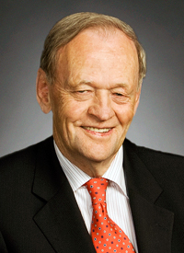
Jean Chretien
- Improvement in Canadian economy, including eliminating deficit and a budget surplus for five straight years
- passed Clarity Bill saying Quebec can only separate after a solid majority votes "yes" on a clear question.
- active social agenda included Child Tax Benefit
- ratified Kyoto Protocol
- supported the war on terrorism but would not send troops to Iraq without UN resolution for military action

Slide 40
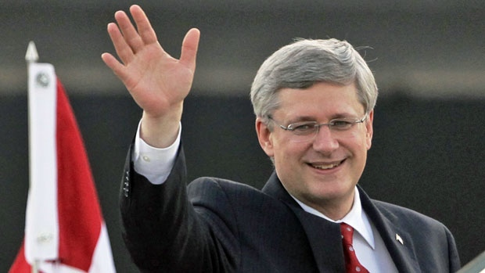
Stephen Harper
People were tired of Liberal gov’ts
Brought in Conservatives during time of economic downturn (depression)
But Harper remains and wins majority gov’ts until 2015.

Slide 41
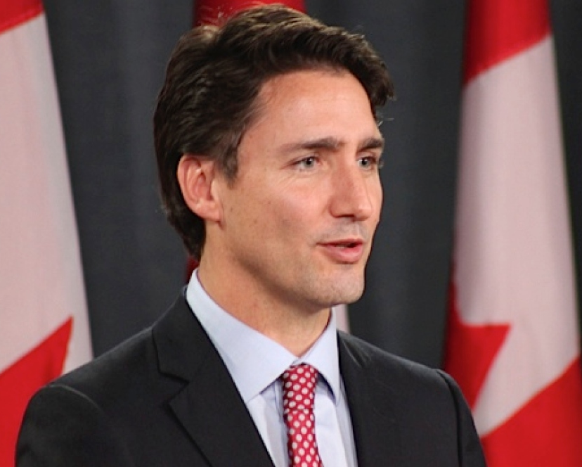
Justin Trudeau
Liberal Prime Minister
2016 - ?
Promised to take in 10,000 Syrian Refugees
Removed Canadian war planes from Syria
Focus on Canada as progressive, youthful, inclusive, welcoming?
Picked a balanced Cabinet (females, minorities)
Attends pride parades.
Environment? Pipelines? Kill one build another.

Slide 42
Class 10

Slide 43
Canada Post WWII : Traditional Values?

Slide 44
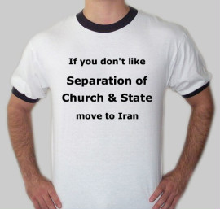

Slide 45
The Gender Gap In Canada
The gender wage gap is the difference between wages earned by men and women.
The most recent Statistics Canada data (2011) shows that the gender wage gap in Canada is 18%
This means that for every $1.00 earned by a male worker, a female worker earns 82 cents.
In 1987, when the Pay Equity Act was passed, the gender wage gap was 36%. The gender wage gap has been narrowing slowly over time.

Slide 46
http://www.cbc.ca/news/business/wage-gap-oxfam-1.3478938

Slide 47
Causes of The Gender Gap
women choosing or needing to leave and re-enter the workforce in order to meet family care-giving responsibilities, resulting in a loss of seniority, advancement opportunities and wages.
occupational segregation in historically undervalued and low-paying jobs, such as childcare and clerical work.
traditionally lower levels of education (although this is becoming less of a factor as more and more women graduate from all levels of education) **
less unionization amongst female workers
Statisticians estimate that as much as 10 to 15 % of the gender wage gap is due to discrimination.

Slide 48
Full Definition of
GLASS CEILING
- an intangible barrier within a hierarchy that prevents women or minorities from obtaining upper-level positions

Slide 49
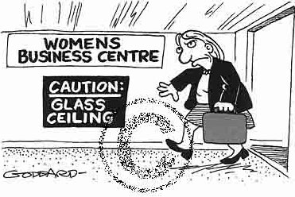
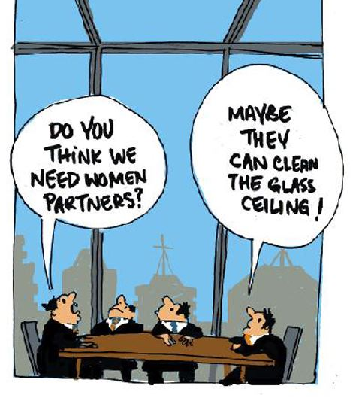

Slide 50
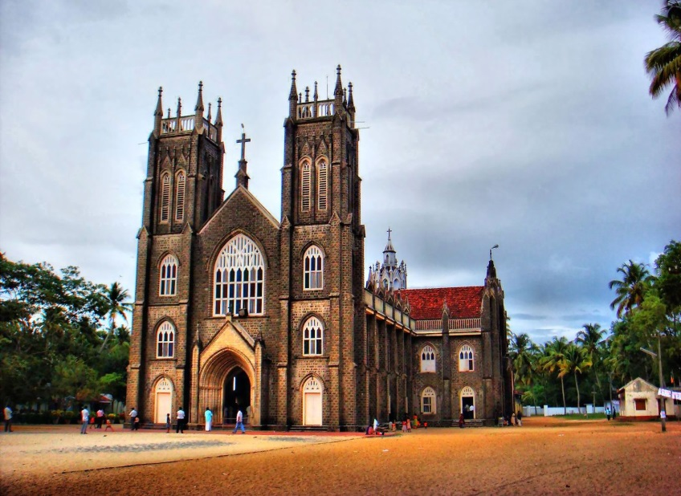
Canada Post WWII : Traditional Values?
Men = breadwinner
Women = Domestic Spheres
Was that true during WWI WWII?
The Church played a daily role in peoples’ lives.

Slide 51
Traditional Values?
Education and Healthcare services were often provided by Church institutions (especially
in rural Canada and Quebec).
Separation of Church
and State

Slide 52
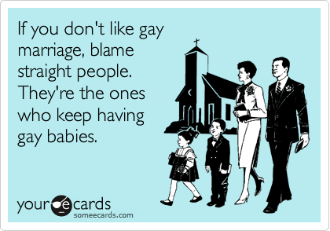
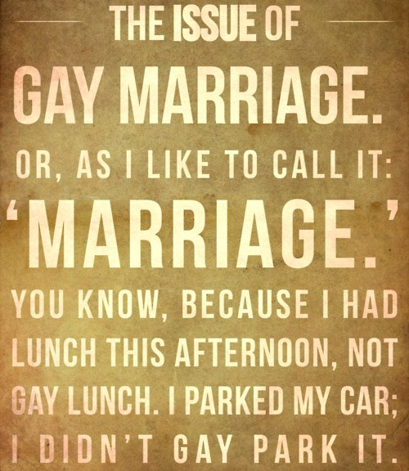

Slide 53
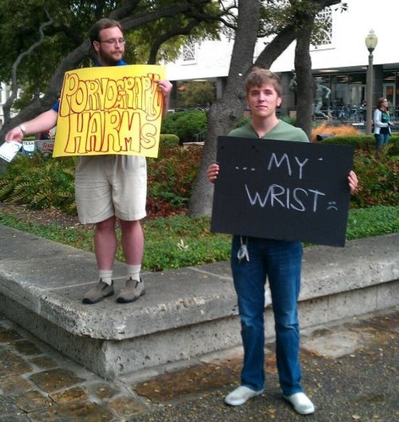

Slide 54
Baby Boomers
People born during the demographic Post–World War II baby boom between the years 1946 and 1964
The postwar baby boom happened because older people, who had postponed marriage and childbirth during the Great Depression and World War II, were joined in the nation’s maternity wards by young adults who were
eager to start families.
Many people in the postwar era
looked forward to having children
because they were confident that
the future would be one of comfort
and prosperity

Slide 55
Your Response: Retire Already! I NEED YOUR JOB!!

Slide 56
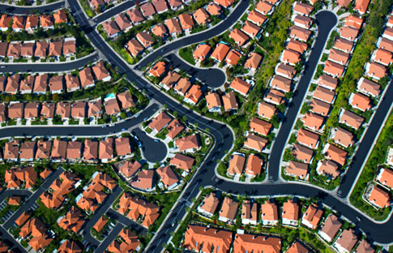
The Growth of Suburbia!
People needed space for new families and the baby boomers.
They started to move out of the cities into the new concrete jungle: Suburbs

Slide 57
Liberalism in the 70s
1) Gender Equality (Not there yet)
2)Racial Equality (Not there yet)
3) Peace and Prosperity (Not there yet)
My argument: Progress can never be judged by time frames, only by our actions!

Slide 58
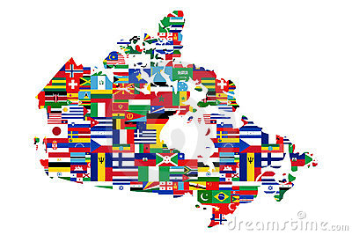
Multiculturalism (vs Melting Pot)
Official policy of Canadian Government since Trudeau’s Liberals:
All Citizens are equal and contribute to the ever- growing Canadian Identity

Slide 60
Unemployment Rate | 2014 | 2015 | 2016 | 2017 | 2018
Canada | 6.9 | 6.9 | 7 | 6.3 | 5.8
NFL | 11.9 | 12.8 | 13.4 | 14.8 | 13.8
Prince Edward Island | 10.6 | 10.4 | 10.7 | 9.8 | 9.4
Nova Scotia | 9 | 8.6 | 8.3 | 8.4 | 7.5
New Brunswick | 9.9 | 9.8 | 9.5 | 8.1 | 8
Quebec | 7.7 | 7.6 | 7.1 | 6.1 | 5.5
Ontario | 7.3 | 6.8 | 6.5 | 6 | 5.6
Manitoba | 5.4 | 5.6 | 6.1 | 5.4 | 6
Saskatchewan | 3.8 | 5 | 6.3 | 6.3 | 6.1
Alberta | 4.7 | 6 | 8.1 | 7.8 | 6.6
British Columbia | 6.1 | 6.2 | 6 | 5.1 | 4.7
Yukon | 4.3 | 6.3 | 5.6 | 3.6 | 2.7
Northwest Territories | 7.9 | 8.3 | 7.4 | 6.6 | 7.3
Nunavut | 13.8 | 15.9 | 14.9 | 14.6 | 14.1

