Slide 1
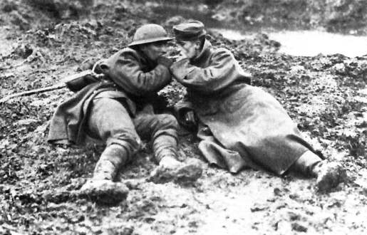
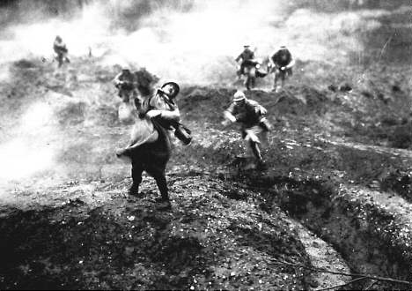
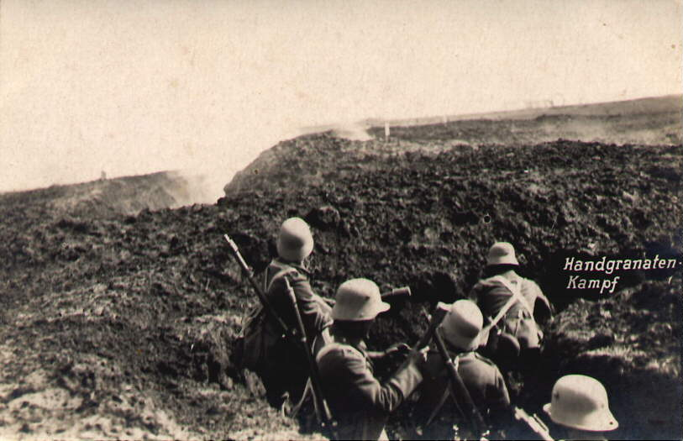
World War 1: Introduction

Slide 2
5 Causes of WWI
Militarism
Imperialism
Nationalism
System of Alliances
Assassination of Franz Ferdinand

Slide 3
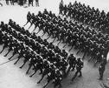
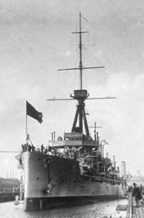
Militarism
Situation in which military interests dominate government policy
All men aged 18-60 in Germany, England, France, Russia and Italy were fully trained and prepared for service in the army
Armed conflict (war) viewed as an acceptable solution to solving problems
Both Germany and Great Britain were engaged in an “arms race”, much like the US and the Soviet Union during the Cold War
HMS Dreadnought

Slide 4
Imperialism
The practice of one country extending its control over the territory, political system, or economic life of another country
Creating Empires
European countries were competing for territories throughout Africa and Asia
Tensions at home increased at home as a result of actions abroad

Slide 6
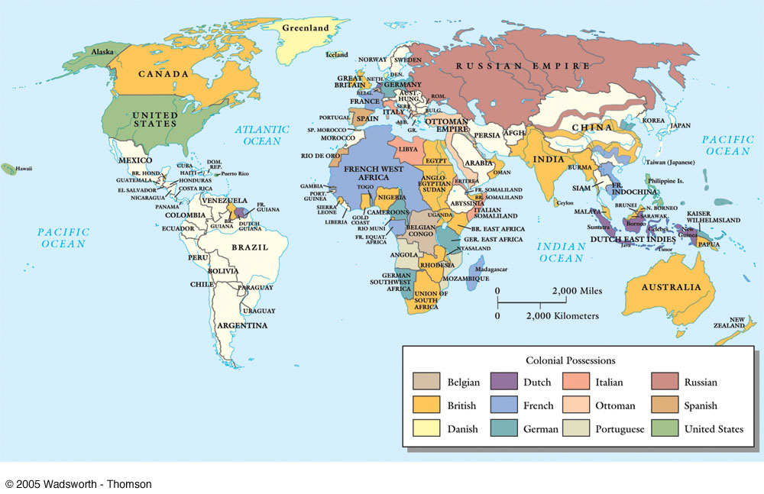
Imperialism
European countries were competing for territories throughout Africa and Asia
Actions abroad often increased tensions at home

Slide 7
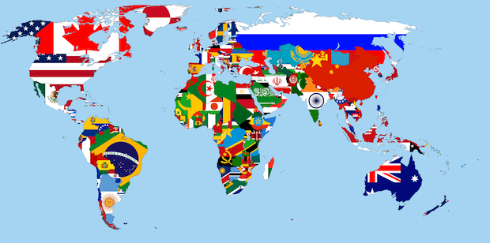
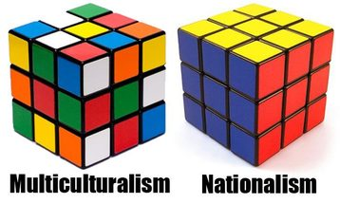
Nationalism
2 Types
Feelings of pride for one’s own COUNTRY
Most citizens at that time were “extremely” patriotic towards their country
Feelings of pride within an ethnic group that does not have its own country (ie. Quebec)
Austria-Hungary had 11 different groups that were nationalistic and who wanted independence
Which countries were created from Austria-Hungary???

Slide 8
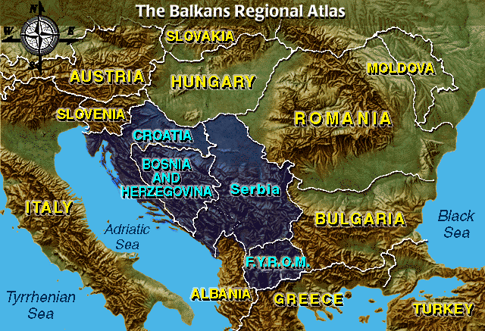

Slide 9
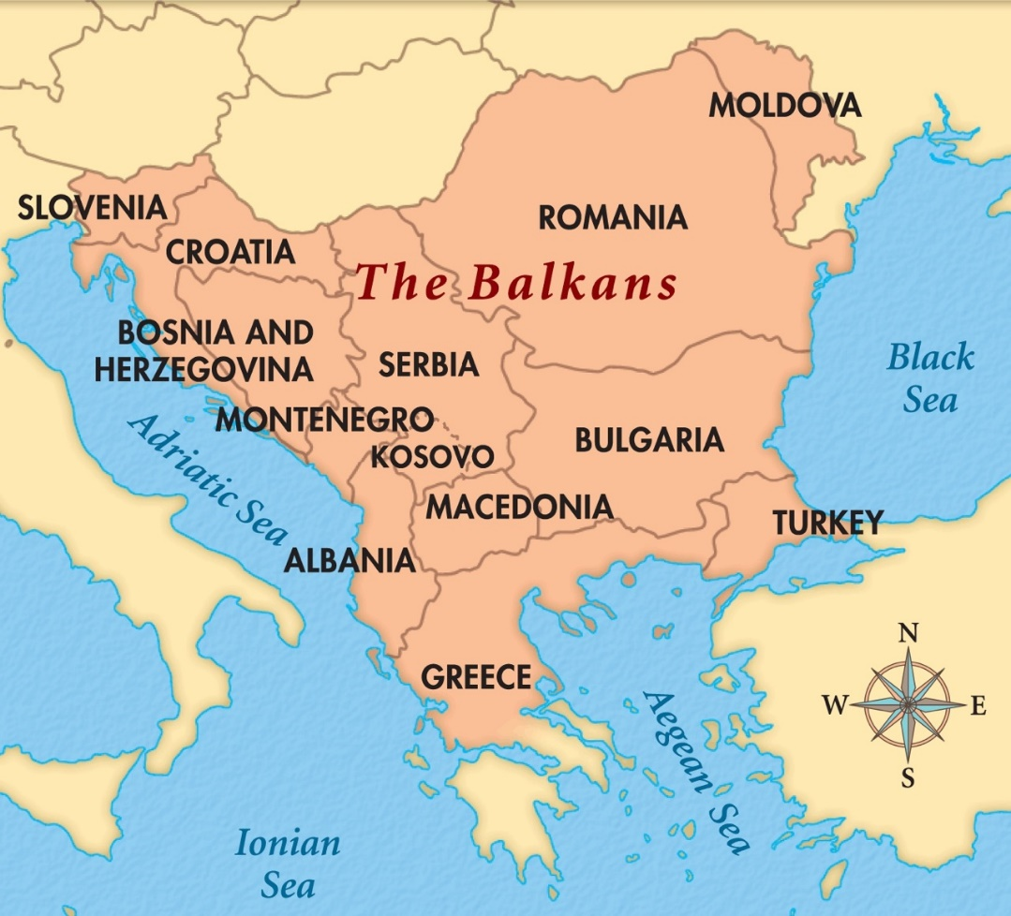
Nationalism – The Balkans
The Black Hand was an organization determined to free Bosnia from Austria-Hungary so that it could join with Serbia
Other rebellions also took place in The Balkans
The Balkans were known as the “powder keg of Europe”

Slide 10
System of Alliances
An organization of people (or countries) involved in a pact or treaty
Serbia was allied with Russia.
Russia was allied with France.
France was allied with Great Britain.
Great Britain was allied with Belgium.
Austria-Hungary was allied with Germany.
Germany and Austria-Hungary were allied with Italy.

Slide 11
Alliances
Triple Entente
Britain, France and Russia
Triple Alliance
Germany, Austria-Hungary and Italy

Slide 12
The Spark that Ignited the War
Austrian Archduke Franz Ferdinand is killed in Sarajevo on June 28, 1914 by Gavrilo Princip, a member of the Serbian nationalist organization, the “Black Hand” (Terrorists)

Slide 13
The World at War
As a result of the complex system of alliances, most of Europe was at war by August, 1914.
As a member of the British Empire, Canada is automatically at war. Many Canadians cheered when they heard the news.

Slide 14
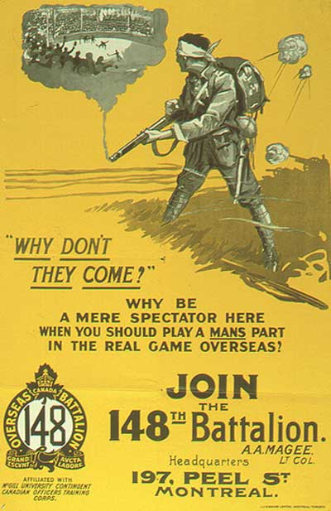
Canada’s War Posters

Slide 15
(End of Notes)
https://www.youtube.com/watch?v=Cd2ch4XV84s

Slide 16
5 Causes of WWI
Militarism
Imperialism
Nationalism
System of Alliances
Assassination of Franz Ferdinand

Slide 17
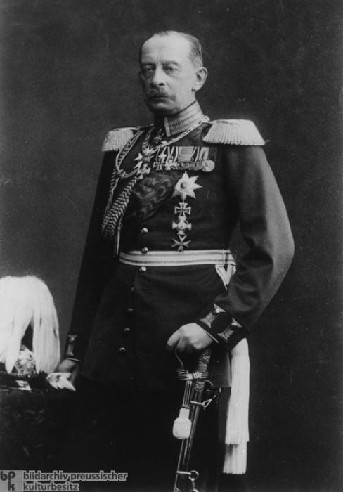
Schlieffen Plan
German surprise attack strategy for a two-front war
Attack France through Belgium in the West
(6 weeks)
Then attack Russia to the East once France was captured
Schlieffen predicted Russia would not have time to mobilize (get its army ready to fight) , as it is a very big country
HE WAS WRONG!
Created by General Alfred von Schlieffen in December 1905

Slide 18
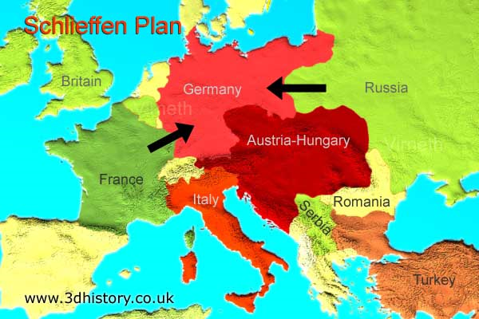
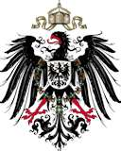

Slide 19
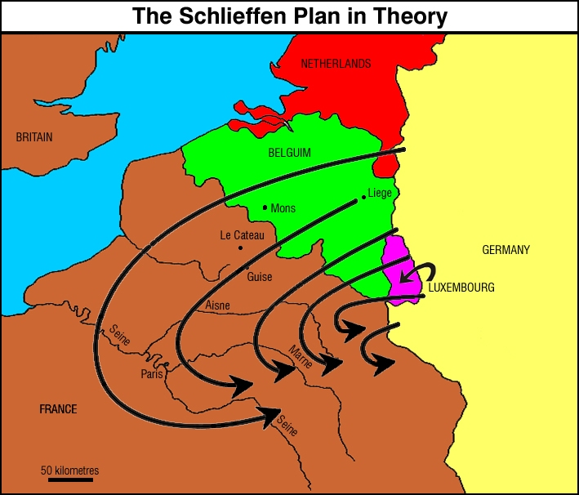

Slide 20
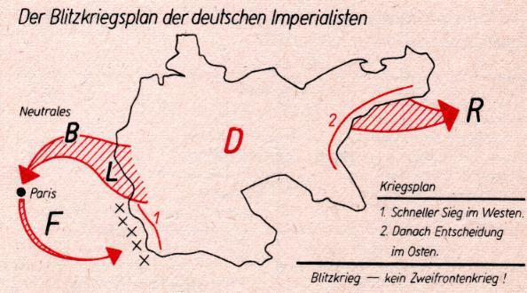
Schlieffen Plan failed!!
The Schlieffen Plan had failed, and Germany was now committed to fighting a two-front war with France and Britain in the West and Russia in the East.
Belgium had had her neutrality guaranteed by Britain in 1839 – so the strategy’s success depended on Britain not supporting Belgium. They did!
The Schlieffen Plan was put into use, as Germany invaded Belgium, resulting in Britain declaring war on Germany on August 4th, 1914

Slide 21
The German Army was stopped 35km from Paris, and the French and British Armies pushed them back to North France, where both sides dug trenches and both sides spent the next 4 years fighting over the area between Belgium and France. It was a stalemate!

Slide 22
TRENCH WARFARE

Slide 23
Europe was divided up and a stalemate ensued.
Trench lines were drawn as soldiers camped down.
Technological advancements turned the tide of war into Defence–oriented tactics.
https://www.youtube.com/watch?v=_G4ZY66BG38

Slide 24
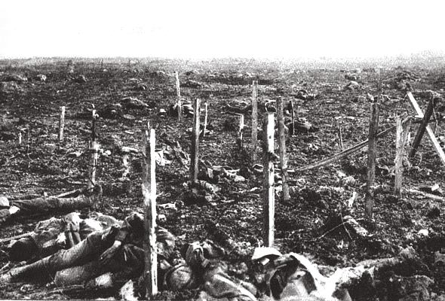
Trench Warfare Characteristics
No Man’s Land: Area between each side.
Going over the Top: Charging towards enemy front lines.
Barbed Wire and Machine guns kept advancements at bay.

Slide 25
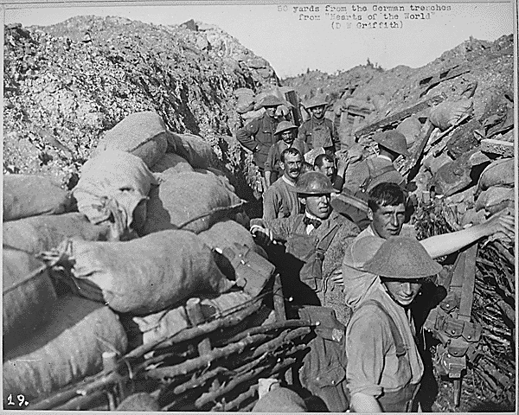
Trench Conditions
Soldiers fought, ate and slept in trenches.
Insect infestations and rats.
Disease, fever, flu, trench foot.

Slide 26
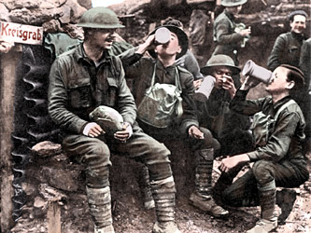

Slide 27
Canada’s Response to WWI: The War Measures Act
PM Borden introduced the War Measures Act almost immediately after war was declared.
This granted the Canadian government the authority to do everything necessary “for the security, defence, peace, order, and welfare of Canada.”
The act also gave the gov’t power to strip ordinary Canadians of their civil liberties.
Many German’s and Austro-Hungarians were treated harshly under this act having to carry identification cards and over 8000 were held in isolation in internment camps.

Slide 28
Significant Battles for Canada: Vimy Ridge
April 9, 1917
Canadian troops led by General Julian Byng
Byng developed strategies for attack, trained and rehearsed movements of troops
Canadian troops followed plan of attack and in less then 2 hours completed their objectives
April 10 Canadian troops captured the highest point of the ridge

Slide 29
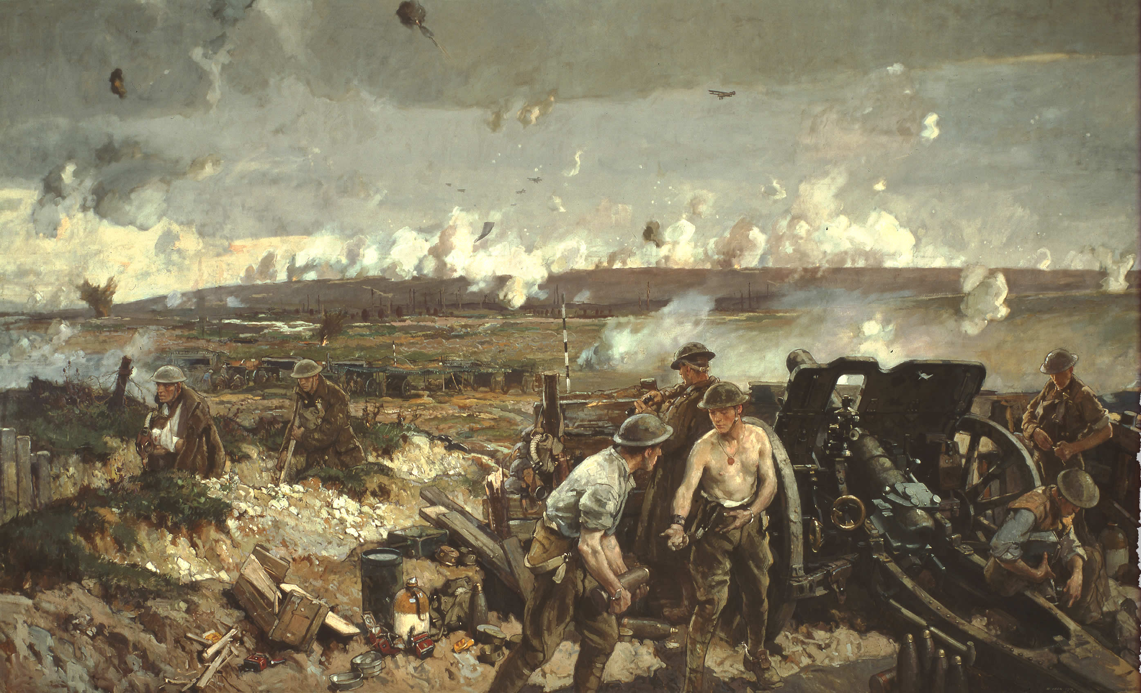
Vimy Ridge

Slide 30
Significant Battles for Canada: Vimy Ridge
Canadians gained more ground, took more prisoners, and captured more artillery then any previous British offensive in the entire war
Cost of victory was high: 7000wounded, 3500 killed
The Victory marked a Canadian milestone and contributed to a sense of national identity.
Debate: should we spend $$ on memorials?

Slide 31
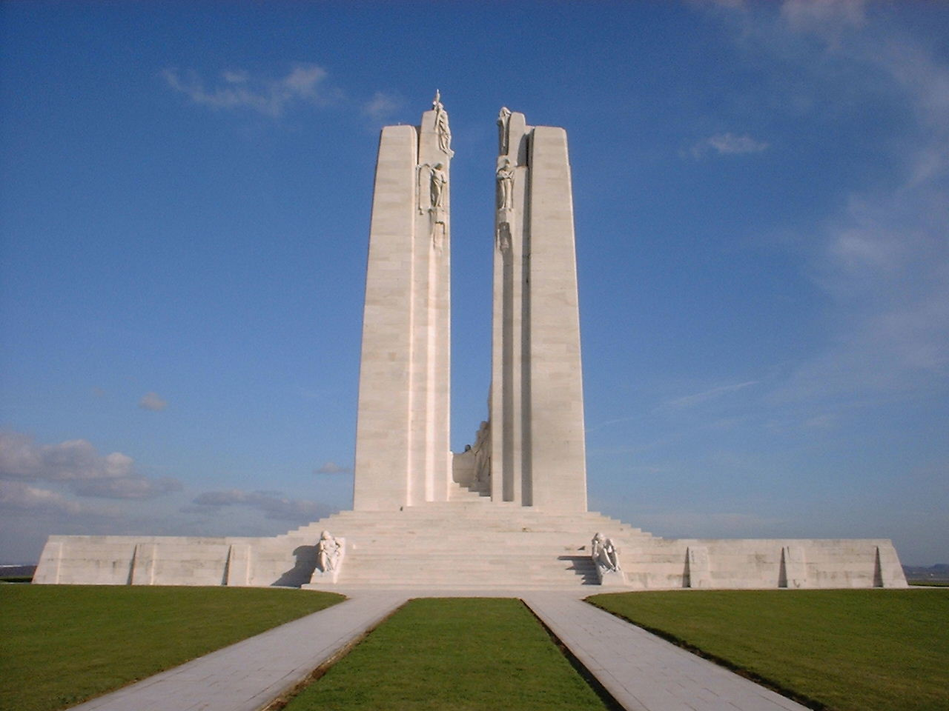
Vimy Ridge Memorial, France

Slide 32
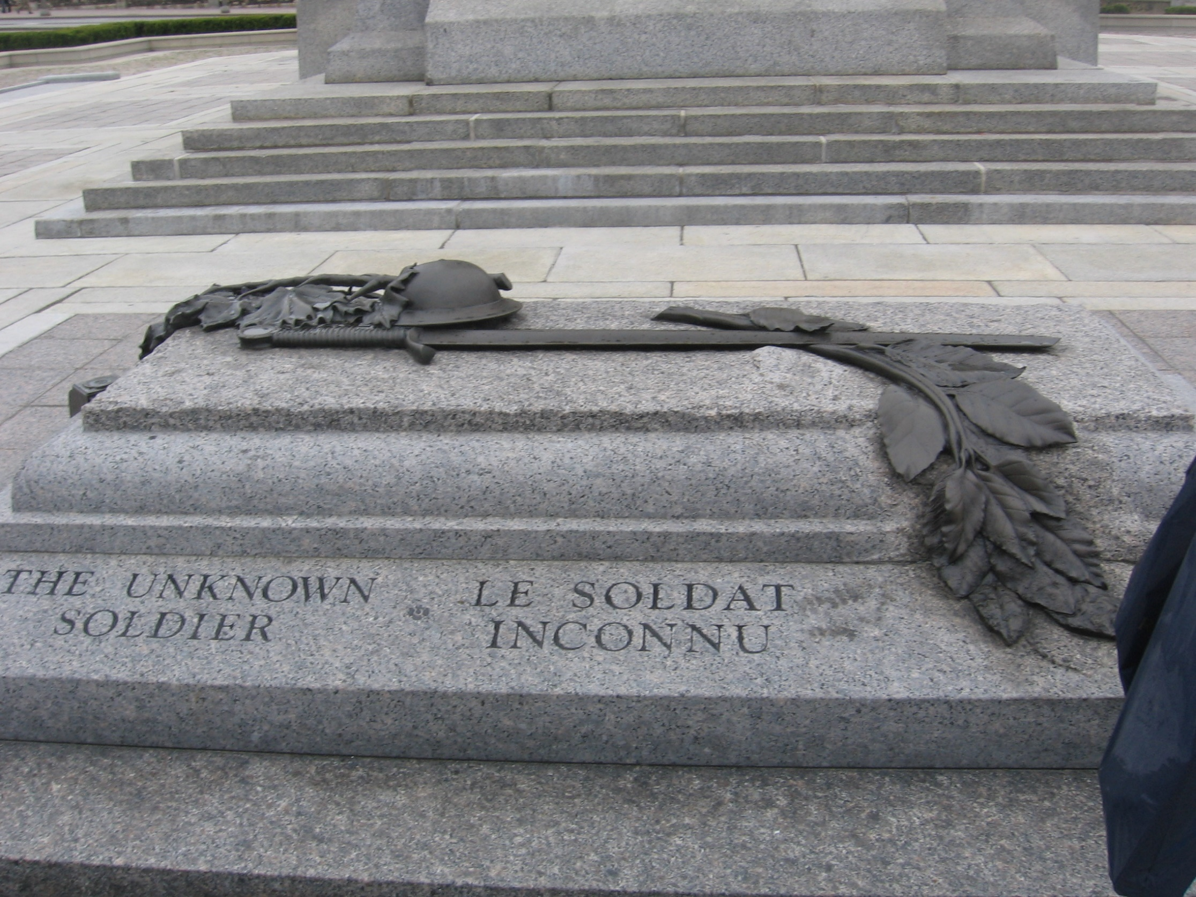
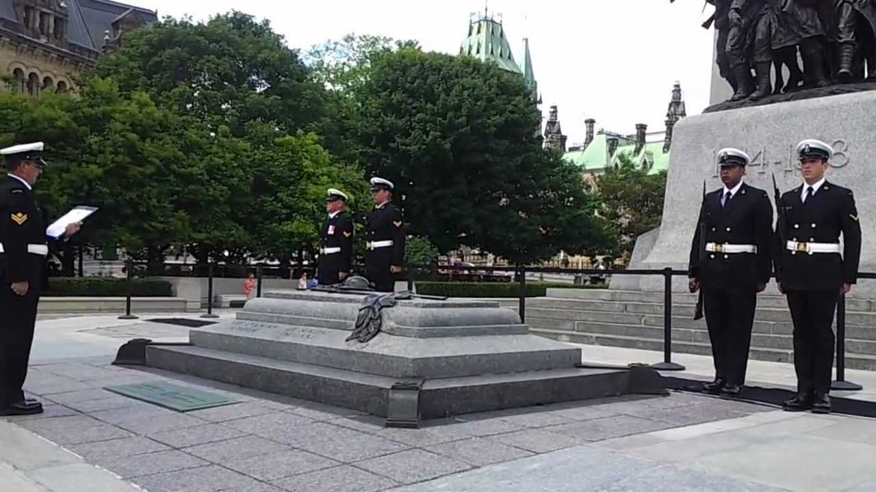
TOMB OF THE UNKNOWN SOLDIER, OTTAWA

Slide 33
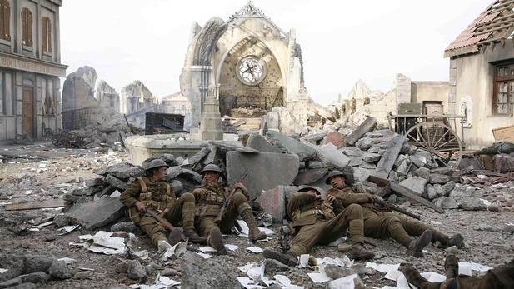

Slide 34
https://www.youtube.com/watch?v=NWF2JBb1bvM
Sainsburys

Slide 35
War in the Air
New technology added the ability to scout enemy lines, discover positions and drop bombs on land and at sea.
Billy Bishop was Canada’s most famous flying “ace” with 72 kills
Gave Canadians hope, something positive to talk about as realities of the war began to arrive on the home front.

Slide 36
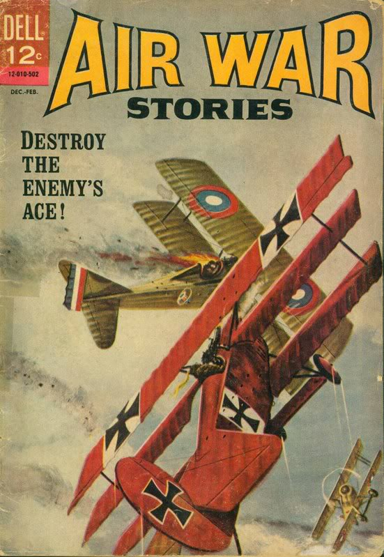

Slide 37
War at Sea
German U-boats were a threat to British supply route across the Atlantic
Canada’s merchant marines were given the task of bringing munitions and food supplies across the Atlantic to Britain
Halifax was a key base for refueling and repairing allied warships
Merchant marines initially did not receive any veteran benefits after the war was over

Slide 38
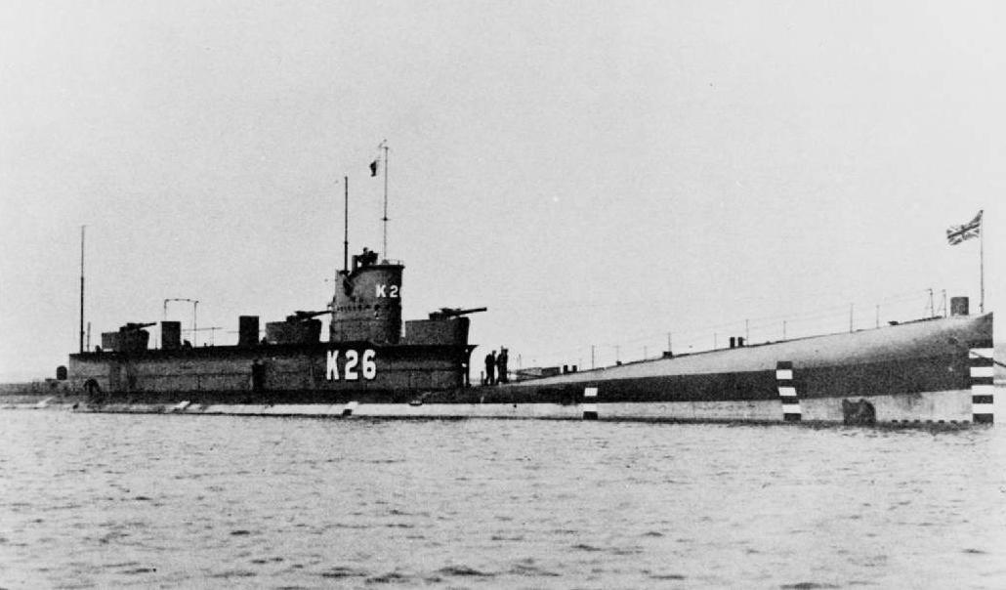
WAR AT SEA

Slide 39
Halifax Explosion
The collision between two ships in the Halifax harbour ignites an explosion un-matched until the dropping of atomic bombs on Japan at the end of WWII
The explosion devastates the harbour
Over 2000 are killed and 10,000 are injured in explosion

Slide 40
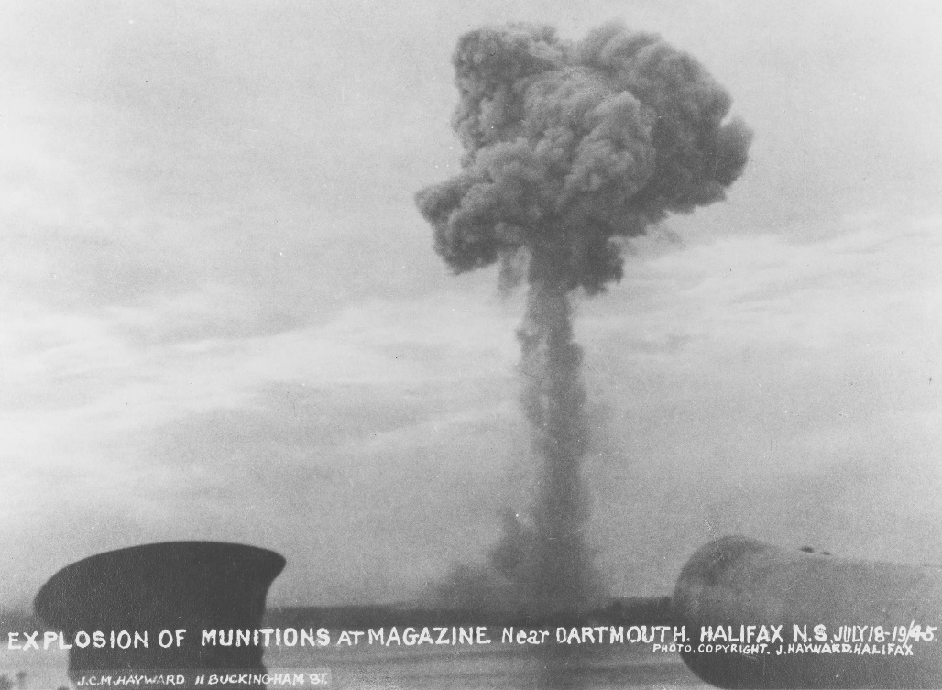
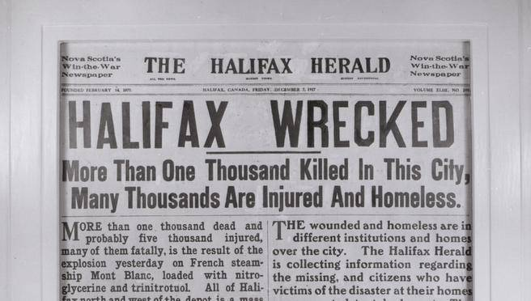
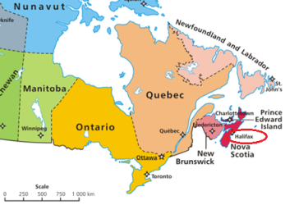

Slide 41
The War at Home
In order to raise money for the war, the Canadian government introduced a temporary income tax
The government also issued Victory bonds and used propaganda to encourage citizens to buy them
Because of their success, bonds and income tax became permanent fixtures for Canadian citizens

Slide 42
Women on the Homefront
Women took jobs where ever there was a labour shortage: machine shops, metal foundries, munitions plants, aircraft factories and shipyards
Even though women worked along side men, they were paid only half the wages men received

Slide 43
Conscription Crisis
When the war began, PM Borden promised no conscription
By 1917, volunteer enlistment had dropped and troops were still needed
Borden introduced Military Services Act: Compulsory military service for all men between 20-45

Slide 44
Conscription Crises
Majority of French Canadians objected
They felt the Act was forcing them to fight a war that was not theirs
They felt enough money had been spent and lives lost
Farmers and industrialists also opposed the Act

Slide 45
1917 Election
PM Borden passed two pieces of legislation to ensure re-election
Military Voters Act: allowed women and men serving overseas to vote
War time Elections Act: gave the vote to women directly related to servicemen
Borden wins the election but conscription divides the country
Only 24,000 troops are deployed to Europe and few saw any action as the war was nearly over

Slide 46
1917 Election
Region | Union Government (Conservative, Borden) | Liberal Government (Laurier)
Atlantic | 21 | 10
Quebec | 3 | 62
Ontario | 74 | 8
West | 54 | 2
Totals | 152 | 82

Slide 47
Canada on the World Stage
PM Borden insists Canada receives its own seat at the Paris Peace Conference
Insists that Canada be among the leaders to sign the Treaty of Versailles which set out the terms of agreement for peace
Participation at the Paris Peace Conference also guaranteed a seat and a vote in the newly formed League of Nations

Slide 48
End of the War
The last 100 days Canadian offensives among the most successful of allied forces
Central powers collapse by 1917
Armistice is signed on November 11, 1917

Slide 49
Canada and the Aftermath of the War
Over 60,000 Canadians lost their lives in Europe
Returned home to the Spanish Flu that killed 50,000 Canadians

Slide 50
Cost of War:
1 in 7 Soldiers at the front lines DIED
(9 Million)
1 in 3 Soldiers were DISABLED
(22 Million)
$400,000,000,000 (400 Billion) in Estimated Damages
(With inflation that is $4 Trillion today)

Slide 51
World War I Casualties

Slide 52
Collective Key Terms:
Armistice
Arms Race
Ultimatum
Two-Front War
Stalemate
Battle of Attrition
Total War
Propaganda
Self-Determination
U-Boats
Rations
Munitions
Victory Bonds
Rationing
Income Tax
Conscription
Suffragettes

