Slide 1
Post-War Canada
League of Nations (5 lines blank)
Post War Years (4 lines blank)
Winnipeg General Strike (5 lines blank)
King-Byng Crisis (4 lines blank)

Slide 2
League of Nations:
Designed to foster international security
Idea of Collective Security
Only works if all major world powers are members
(3 Key ones left out)
Origin of today’s United Nations
Was the league a success?

Slide 3
Treaty of Versailles
World War I officially ended with the signing of the Treaty of Versailles on June 28, 1919.
Negotiated among the Allied powers with little participation by Germany.
Pay reparation payments
League of Nations
Germany loses territory
De-Militaized Zone
Limits on size of Germany’s Miltiary

Slide 4
https://www.youtube.com/watch?v=vrYhLNQMRro
https://www.youtube.com/watch?v=0jycVFL8CNM

Slide 5
Post War Years
Remember, over 60,000 Canadians lost their lives in Europe
Returned home to the Spanish Flu that killed 50,000 Canadians

Slide 6
Post War Years
Women were forced to give up their job and return to the home
Thousands of veterans were demanding jobs and veteran benefits
Many were unemployed
High inflation
Many workers joined unions to bargain for higher pay and better working conditions
Soldiers were unhappy about profiteering

Slide 7
Winnipeg General Strike: May 1919
Metal workers initiated strike in Winnipeg and were supported immediately by 30,000 additional workers
Strike lasted for 6 weeks with climax on “Bloody Saturday”, June 21 1919
Clash of workers against government and business leaders – built up aggression.
Government and business leaders feared a communist style revolution and brutally ended the strike
The Strike marked the beginning of a new working class awareness and political involvement

Slide 8
King-Byng Affair
A political crises in 1926 involving PM Mackenzie King and Governor General Julian Byng over a liquor-smuggling scandal
King and his Liberals lost support of the Progressives and were forced to dissolve parliament
King asked G.G. Byng to call an election, but Byng refused.

Slide 9
King Byng Affair
Byng was eventually forced to call an election.
King campaigned on nationalist sentiments claiming it was undemocratic
King won the election and a governor general has never interfered in the process of government since
Summary: King Byng affair was a step toward autonomy from Britain

Slide 10
The Role of Women: The Person’s Case
Under BNA Act, only “persons” could hold office. Women were not considered persons in the eyes of the law.
Alberta’s famous five led by Emily Murphy challenged the government to clarify the definition of “persons”
1928: Supreme Court decides women are not “persons”
Famous five appeal to the British Privy Council and the decision is overturned
Women could now hold office, be senators and judges

Slide 11
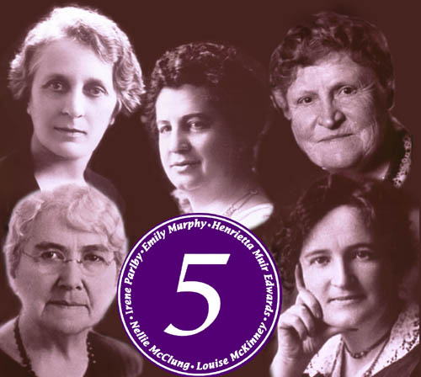

Slide 12
Depression
October 29, 1929 the New York Stock Market crashed sending the world along with Canada into a depression
PM Mackenzie King ousted from office because he appears uncaring
RB Bennett becomes the PM for most of the depression
Nearly 25% of nation is unemployed. Hardest hit are farmers (drought) and young single men

Slide 13
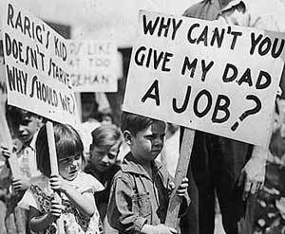
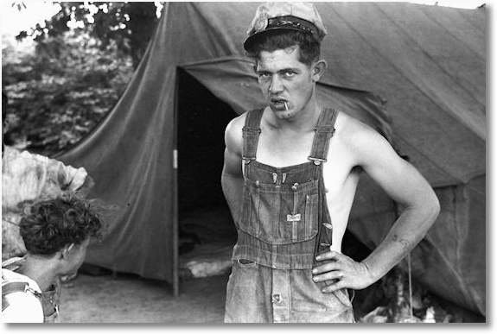
The Depression

Slide 14
The Depression
Bennett creates work camps where men were paid 20 cents/day and lived in horrible conditions
Social unrest grew out of the camps
June of 1935, thousands leave the camps and ride the rail cars heading to Ottawa.
Becomes known as the On-To-Ottawa Trek
Ends in Regina where Bennett orders RCMP to stop the trains. Bennett’s New Deal not enough to keep him in office. Loses 1935 election to Mackenzie King (campaigns “king or Chaos”)

Slide 15
PM’s WW1 – WW2
Sir Robert Laird Borden (1911–20)
Arthur Meighen (1920–21; 1st time)
W.L. Mackenzie King (1921–26; 1st time)
Arthur Meighen (1926; 2nd time)
W.L. Mackenzie King (1926–30; 2nd time)
Richard Bedford Bennett (1930–35)
W.L. Mackenzie King (1935–48; 3rd time)

Slide 16
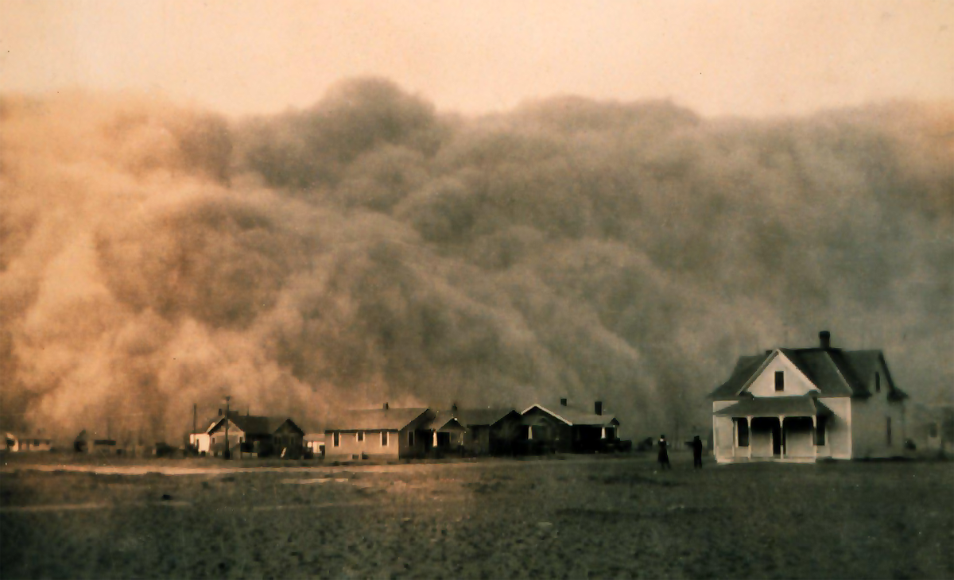
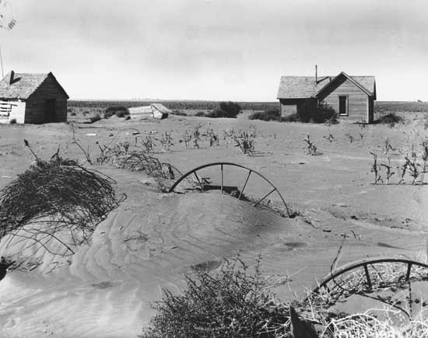
The Dust Bowl

Slide 17
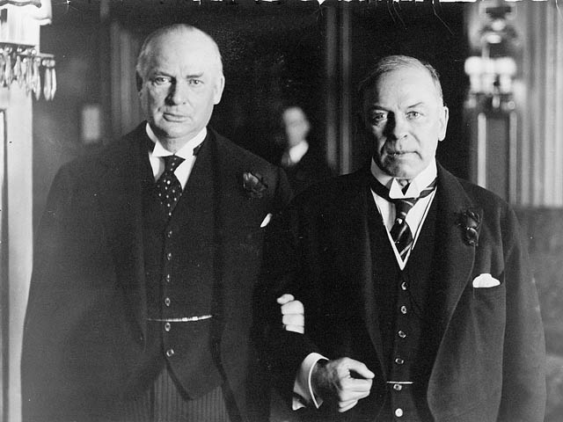
R.B. Bennett (left) and Mackenzie King (right), 1926

Slide 18
Politics of Protest: New Political Parties
CCF: Canadian Cooperative Federation. A federal party with socialist ideals. J.S. Woodsworth leader
Social Credit: Alberta provincial party. Leader is William Aberhart
Union Nationale: Quebec provincial party under Maurice Duplessis.

Slide 19
https://www.bankofcanada.ca/banknotes/bank-note-series/frontiers/

Slide 20
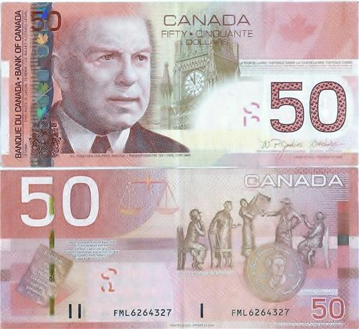

Slide 21
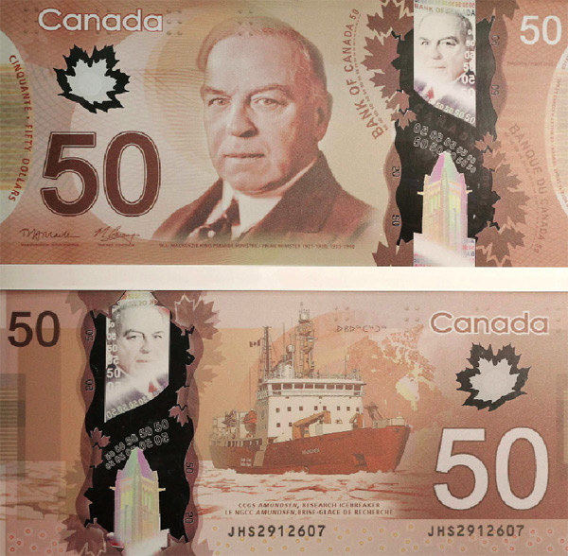

Slide 22
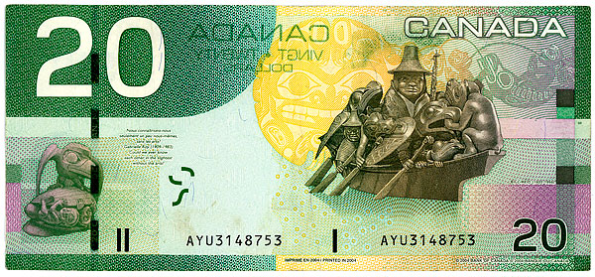
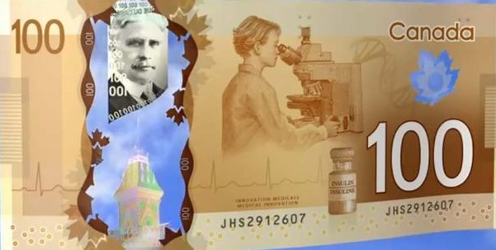
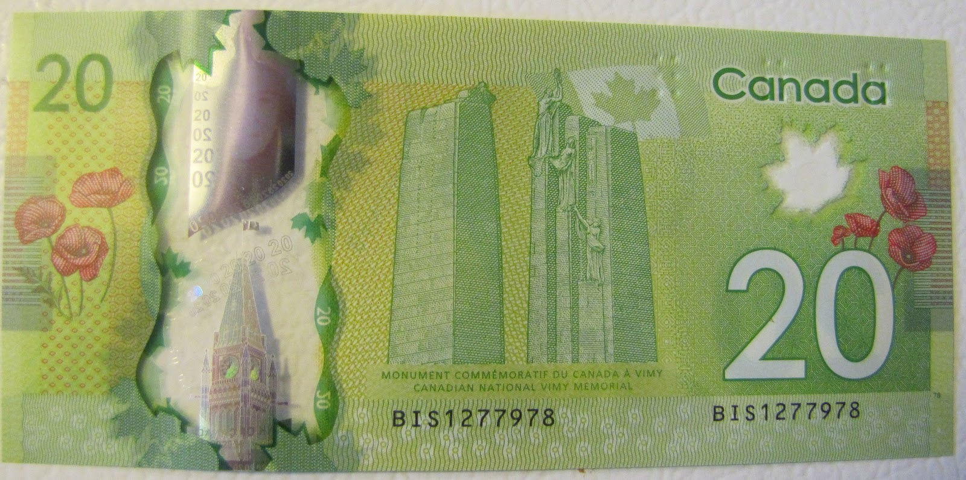
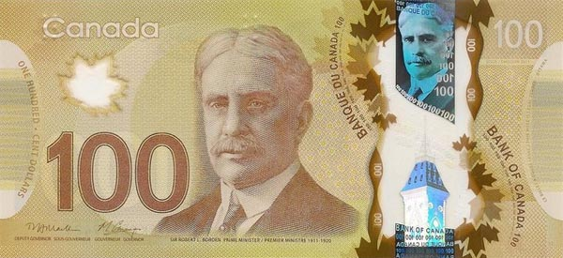

Slide 23
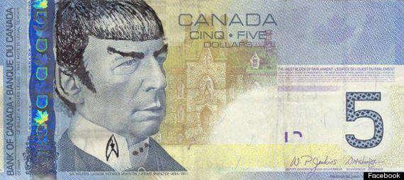
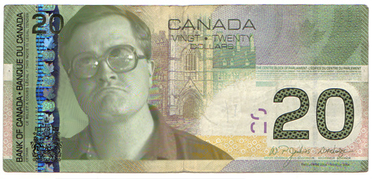
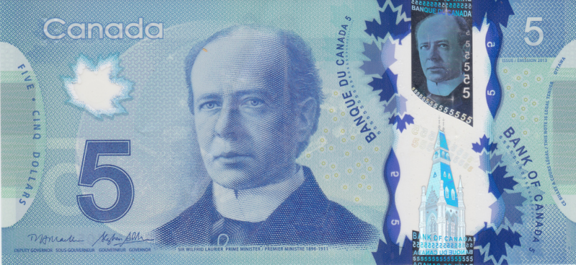

Slide 24
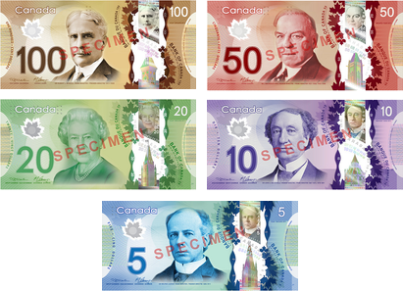

Slide 25
Propaganda!
information, especially of a biased or misleading nature, used to promote or publicize a particular political cause or point of view.

Slide 26
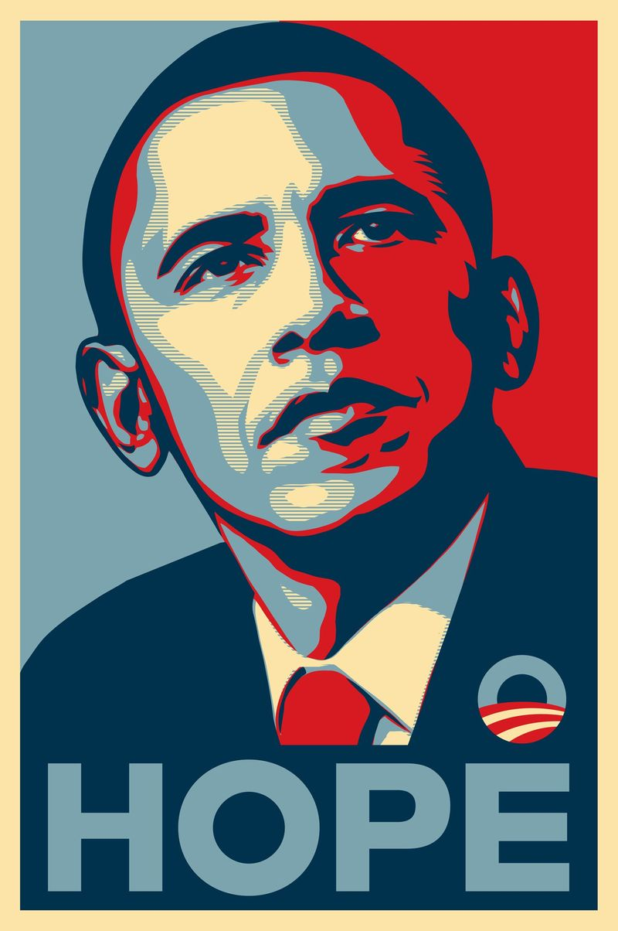
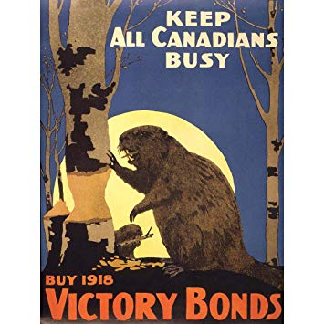

Slide 27
MARKETING
Marketing is the study and management of exchange relationships. Marketing is the business process of creating relationships with and satisfying customers.
Amazon
Apple
Google
Samsung
Facebook
AT & T
Verison
Microsoft
Wall mart

Slide 28
Assignment: Create a Propaganda Poster
GRADING:
Creativity
Uniqueness
Clear Message (reader can tell what your “fighting” for)
Obvious example of Propaganda
Appeal to the Viewer
20 Marks
Due by email to vmartin@sd44.ca or hand in paper copy by tomorrow morning.
Any topic, WW1 not in SS 10 curriculum.
Assessing skills not content!

