Slide 1
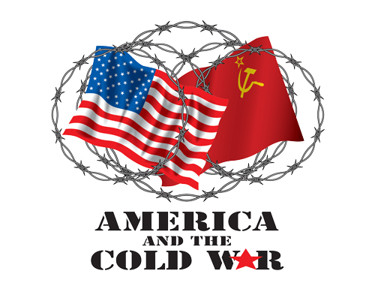
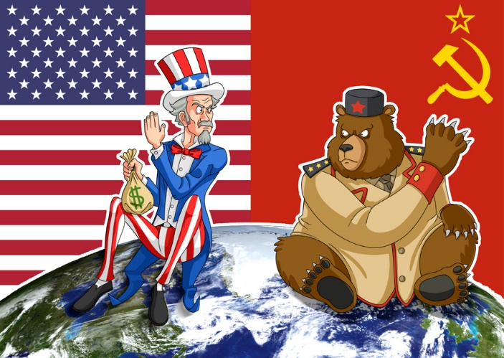
The cold war
1945 – 1990s

Slide 2
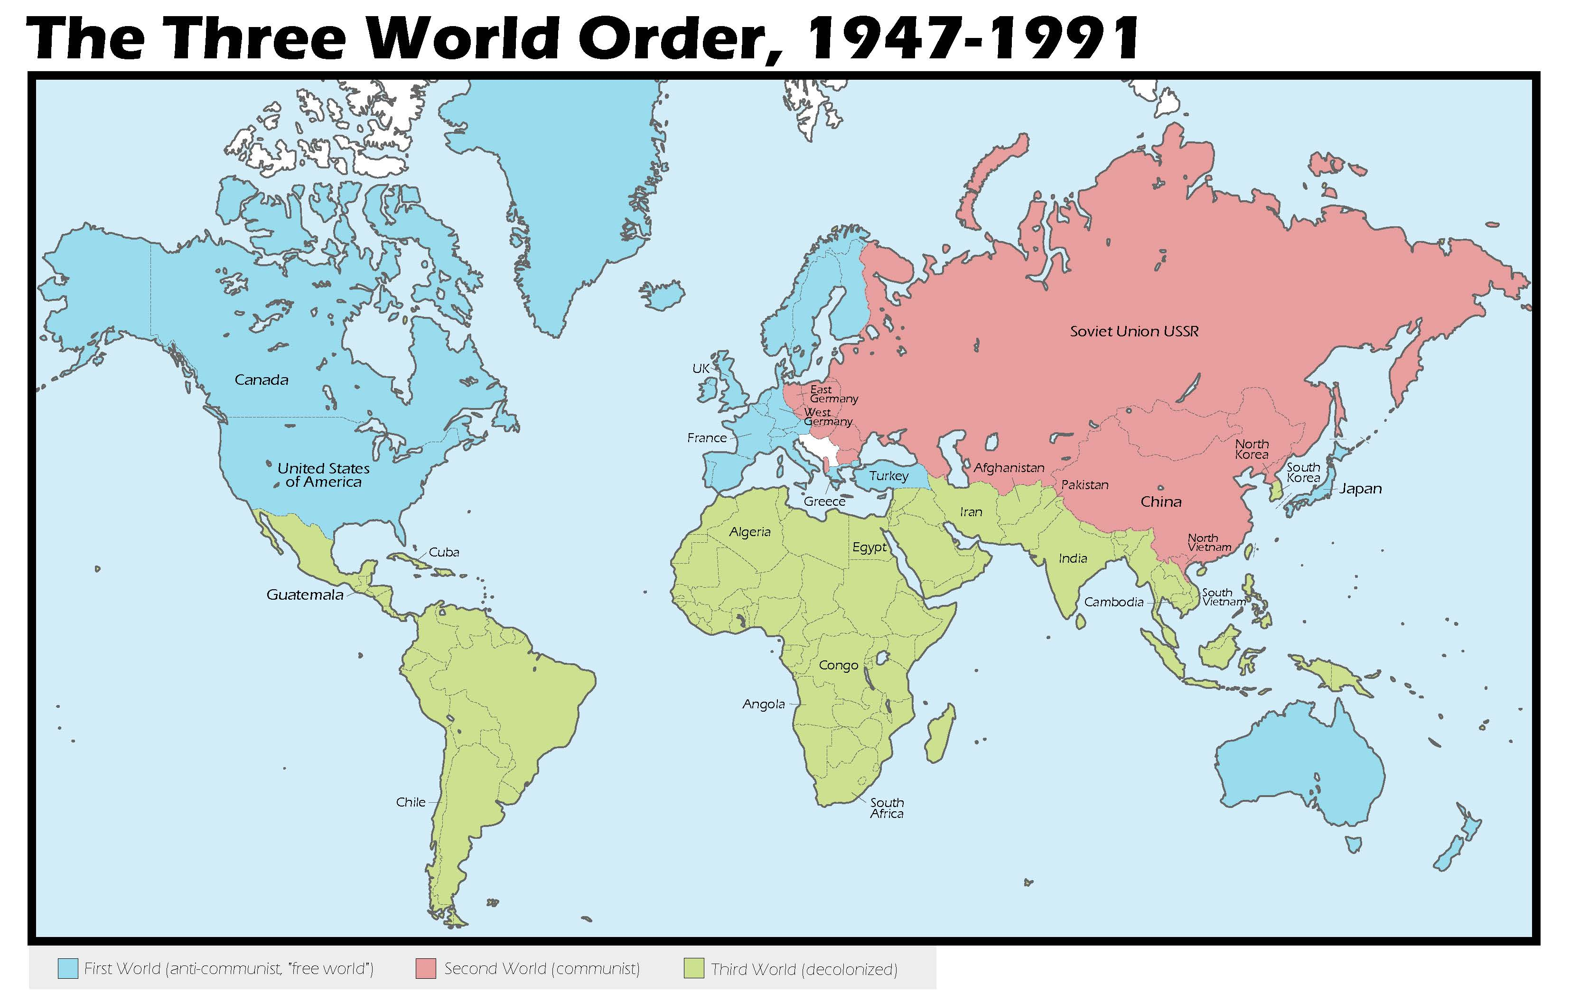

Slide 3
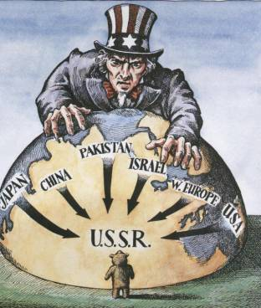
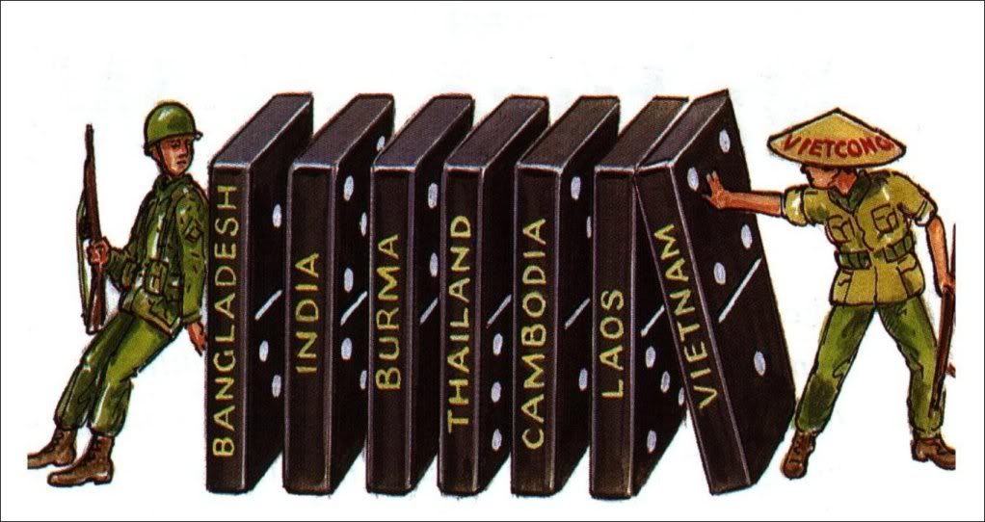
Definitions
Containment Policy: Domino Effect:

Slide 4
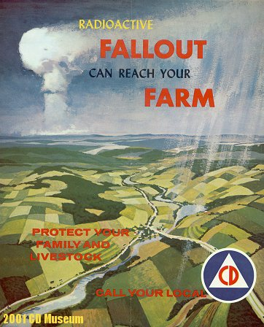
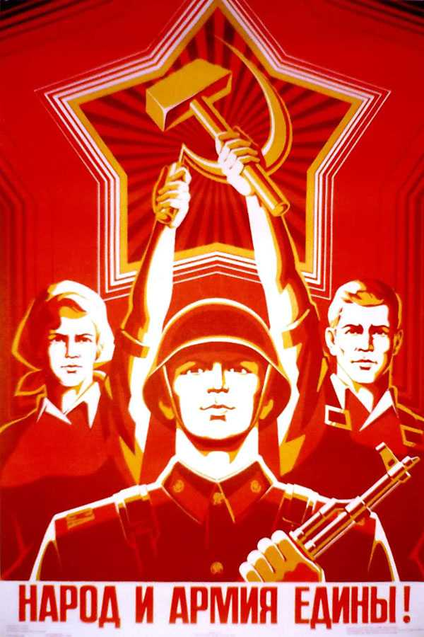
Cold War Propaganda
Ideas, facts, or allegations spread deliberately to further one's cause or to damage an opposing cause.

Slide 5
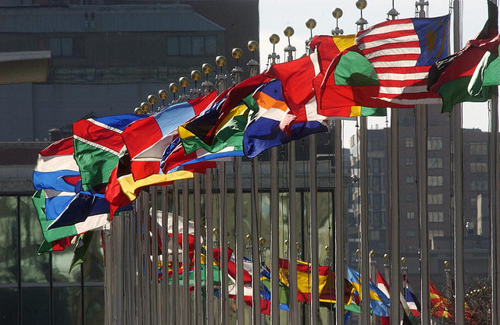
New York City

Slide 6
Canada and the United Nations
In April 1945 the UN was created. It had 4 Mandates:
1) Maintain world Peace
2) Encourage Cooperation
3) Defend Human Rights
4) Improve Standards of Living

Slide 7
UN vs LON
UN had the ability to raise a military force.
United States and USSR Joined right away.
Security Council (China, USA, USSR, Britain, France) have veto powers.

Slide 8
Canada and the United Nations
Canada has always been very supportive of the UN (Canadian John Humphrey - key role in drafting UN Charter)
Peace-keeping missions include Korea, Suez Crises, Somalia, Rwanda, and Afghanistan
Canada has aided refugees from war or natural disasters and worked on development projects in various countries

Slide 9
Nuclear “Proliferation”
1949 the Soviets detonate their first Atomic Bomb
1952 the US detonates a Hydrogen Bomb or “Super bomb”
1955 USSR detonates a Hydrogen bomb: potential destruction of the world now on the table.

Slide 10
Nato vs The Warsaw Pact. Cold War Kicks off
NATO: North Atlantic Treaty Organization created in 1949
Designed to provide mutual defence of all member nations.
(attack one – attack all)
Warsaw Pact: 1955 was the Soviet Response to NATO
Defensive alliance of USSR and its “satellite states”

Slide 11
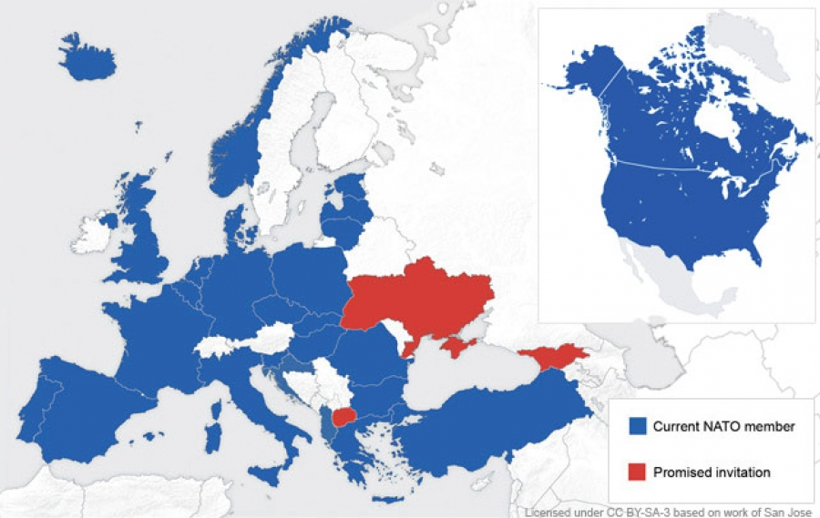

Slide 13
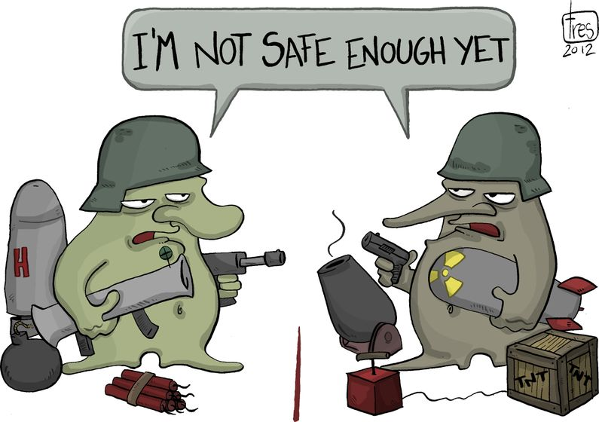
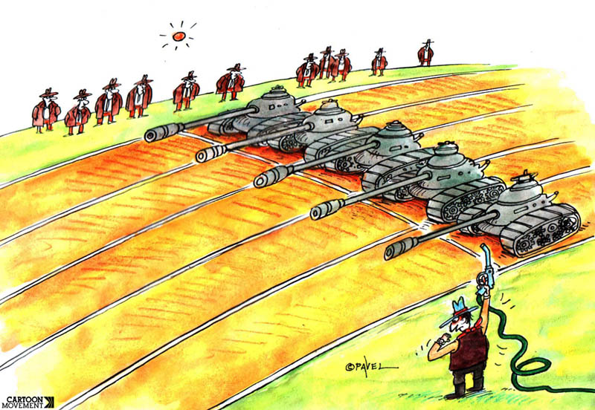
The “Arms Race”

Slide 14
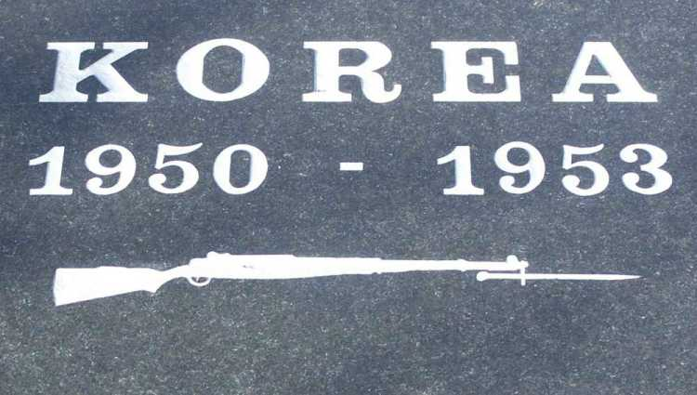
Events of the Cold War #1: The Korean War
After WWII Korea was divided into a Southern Democratic Nation and a Northern Communist Nation.
In June of 1950 North Korea, supported by China and the USSR, invaded South Korea.
Canada joined the UN sanctioned mission to defend the South Koreans. 26,500 Canadian troops ended up fighting this war.
After 3 years a ceasefire was signed and the borders returned to their pre-war status (remains to this day).

Slide 15
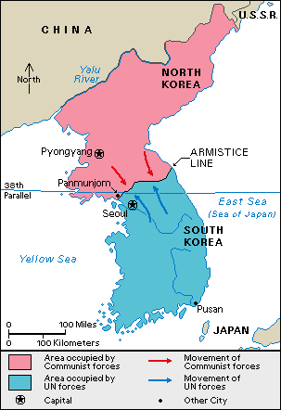
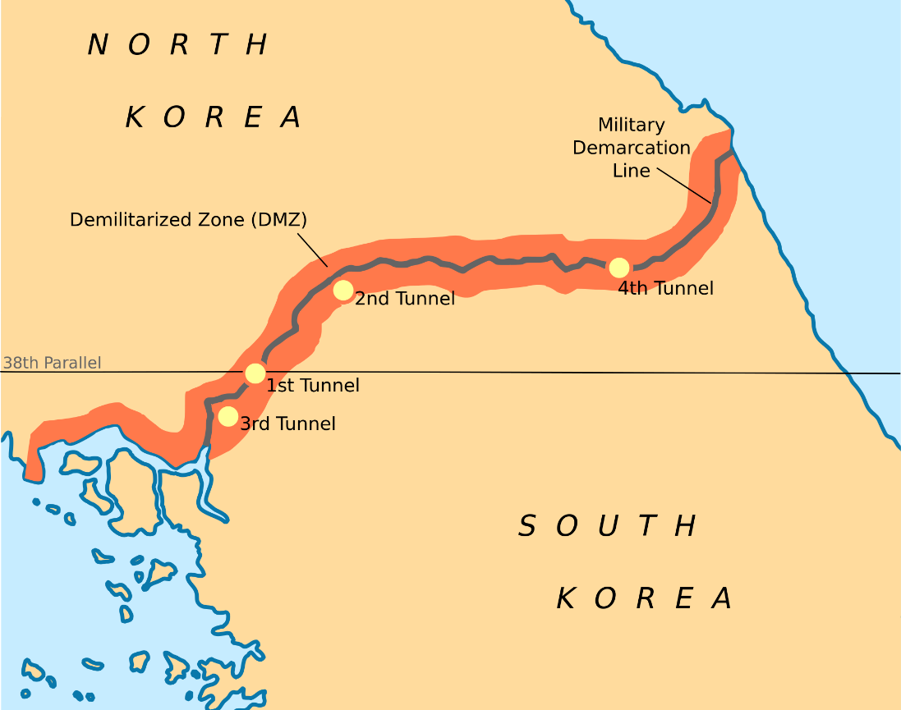

Slide 16
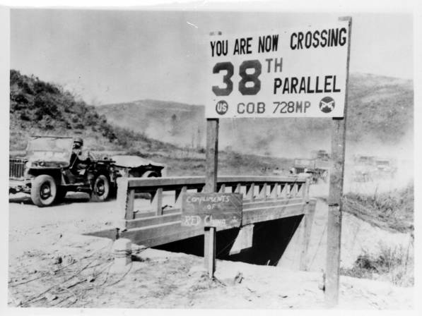
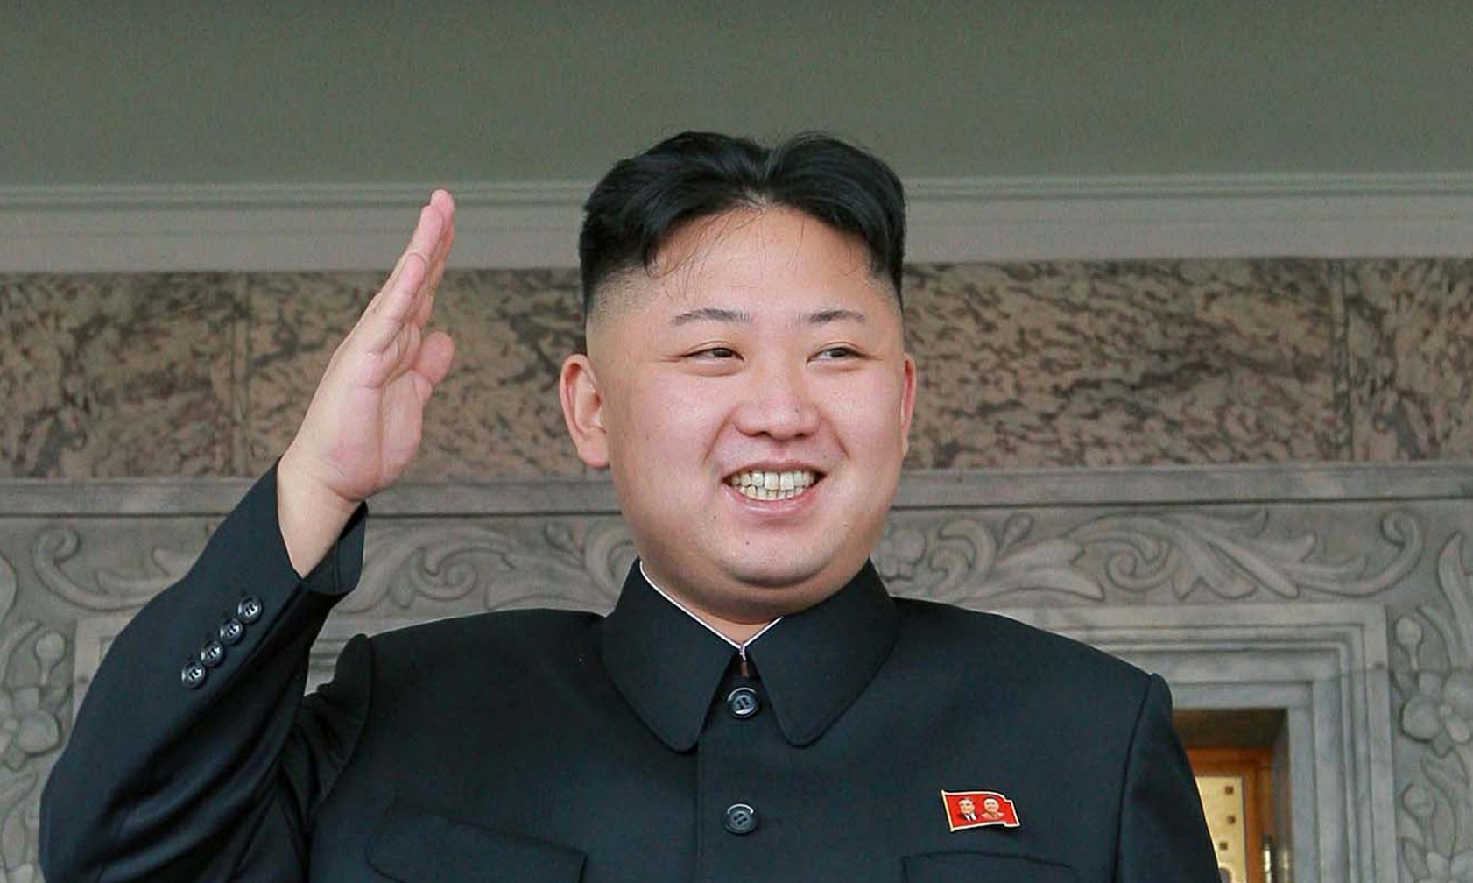

Slide 17
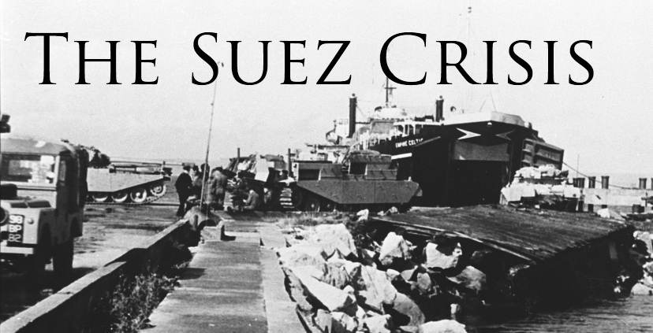
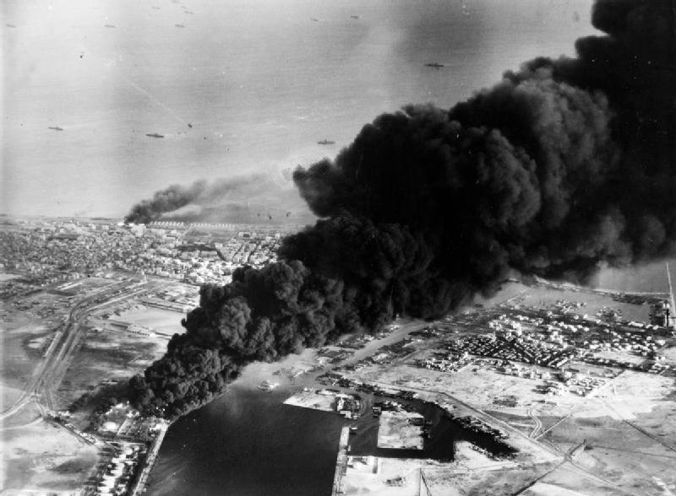
Events of the Cold War #2: The Suez Canal Crisis
The Suez Canal links the Mediterranean and Red Seas, an important shipping route
In 1956 Egypt took over the canal from France and Britain.
The USSR declared support for Eygpt and Isreal declared support for F and B. The world was on the brink of war.

Slide 18
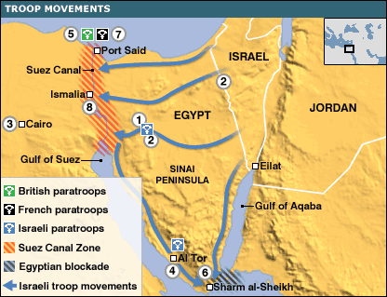

Slide 19
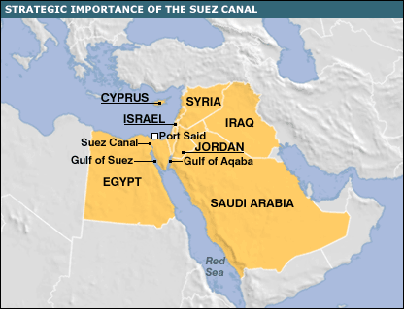
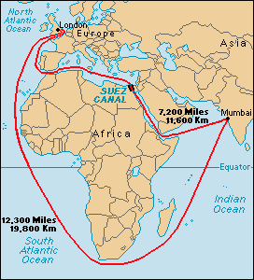

Slide 20
Events of the Cold War #2: The Suez Canal Crisis
Canadian PM Lester Pearson proposed to the UN that an Emergency Force be sent to the Suez Canal to separate and mediate the rival armies of Egypt and Israel.
Lester Pearson won the Nobel Peace Prize in his efforts to defuse the conflict

Slide 21
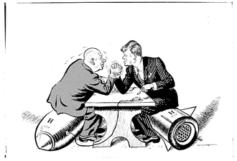
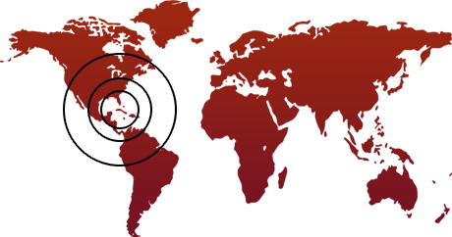
Events of the Cold War #3: Cuban Missile Crisis
BAY OF PIGS
In 1961 the United States gov’t authorized an invasion of Cuba by CIA trained Cuban exiles.
This was a huge failure and gave Cuban leader Fidel Castro justification for his anti-American stance

Slide 22
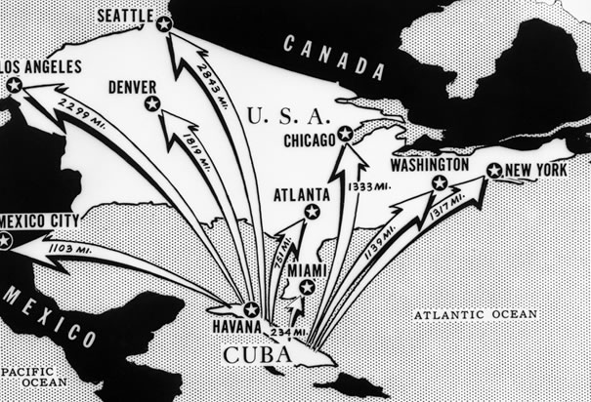
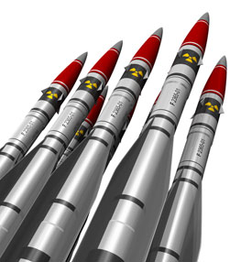
Events of the Cold War #2: Cuban Missile Crisis
The USSR used this as an opportunity to increase their ties with Cuba.
In 1962 American spy planes spotted Soviet missile silos in Cuba.
This was grave news for the US as their response time to launched nuclear missiles went from 30 minutes to potentially only a few minutes.

Slide 23
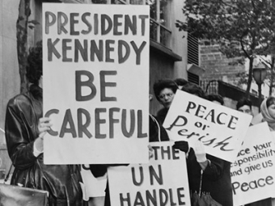
Cuban Missile Crisis
Peace was created when soviets promised to remove the missiles and the US promised not to invade Cuba.
Cuba has remained communist though in 2015 for the first time the United States has begun to recognize Cuba as a legitimate state.

Slide 24
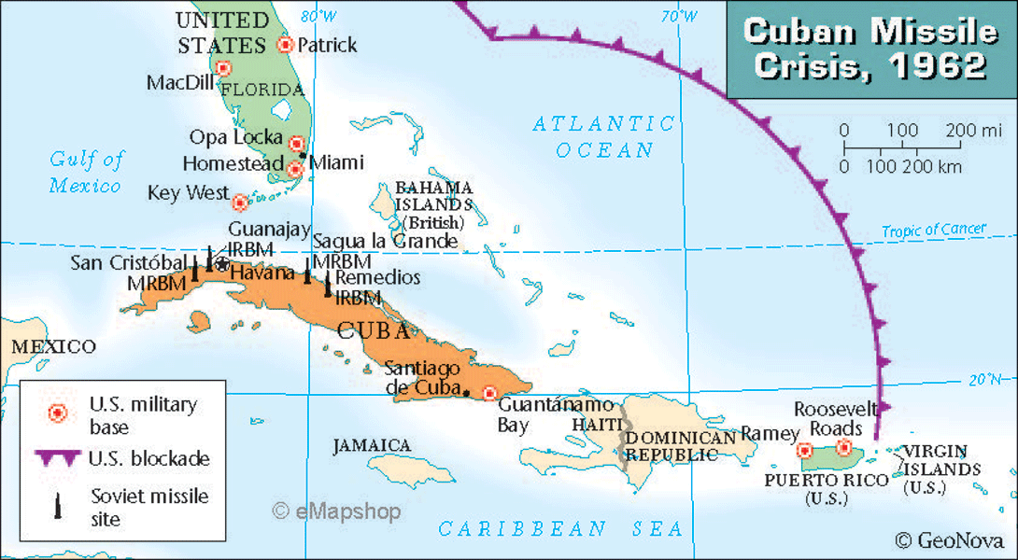

Slide 25
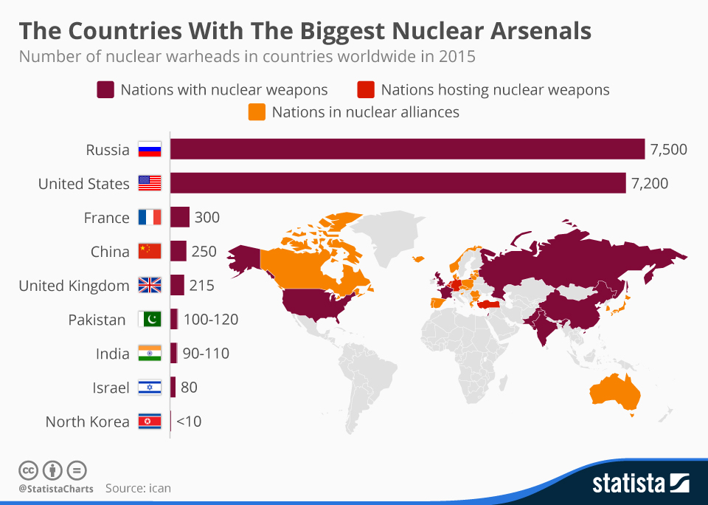

Slide 26
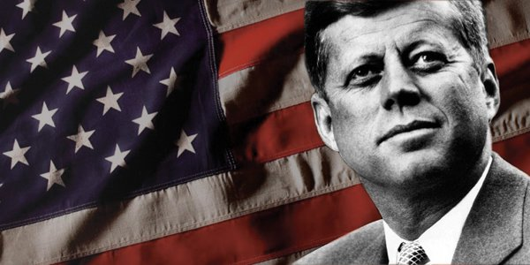
President Kennedy
Elected as a Democrat
in 1961, Kennedy is
known as one of the
most famous US presidents
He was heavily involved in the Cuban Missile Crisis soon after Election.

Slide 27
President Kennedy
In 1963 he was assassinated by Lee Harvey Oswald while driving down a Dallas street.
This event shocked the world.
What events have “shocked” the world in your life?

Slide 28
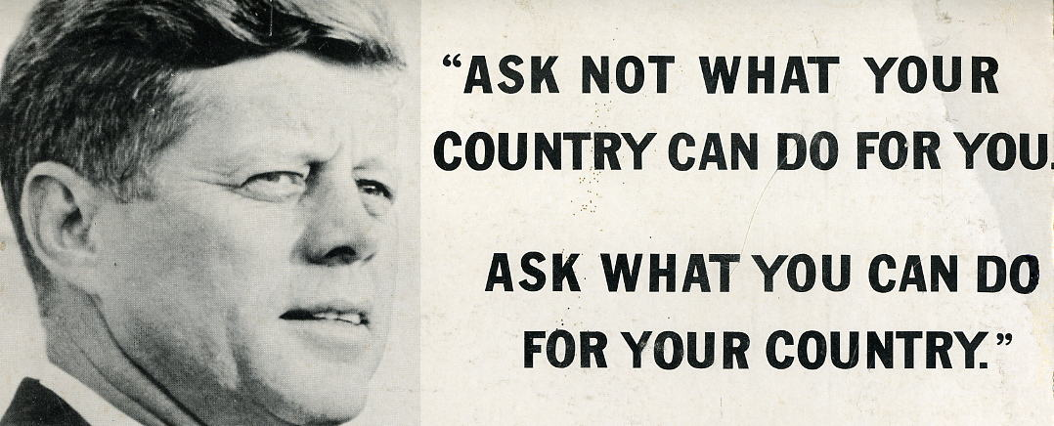
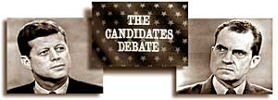

Slide 29
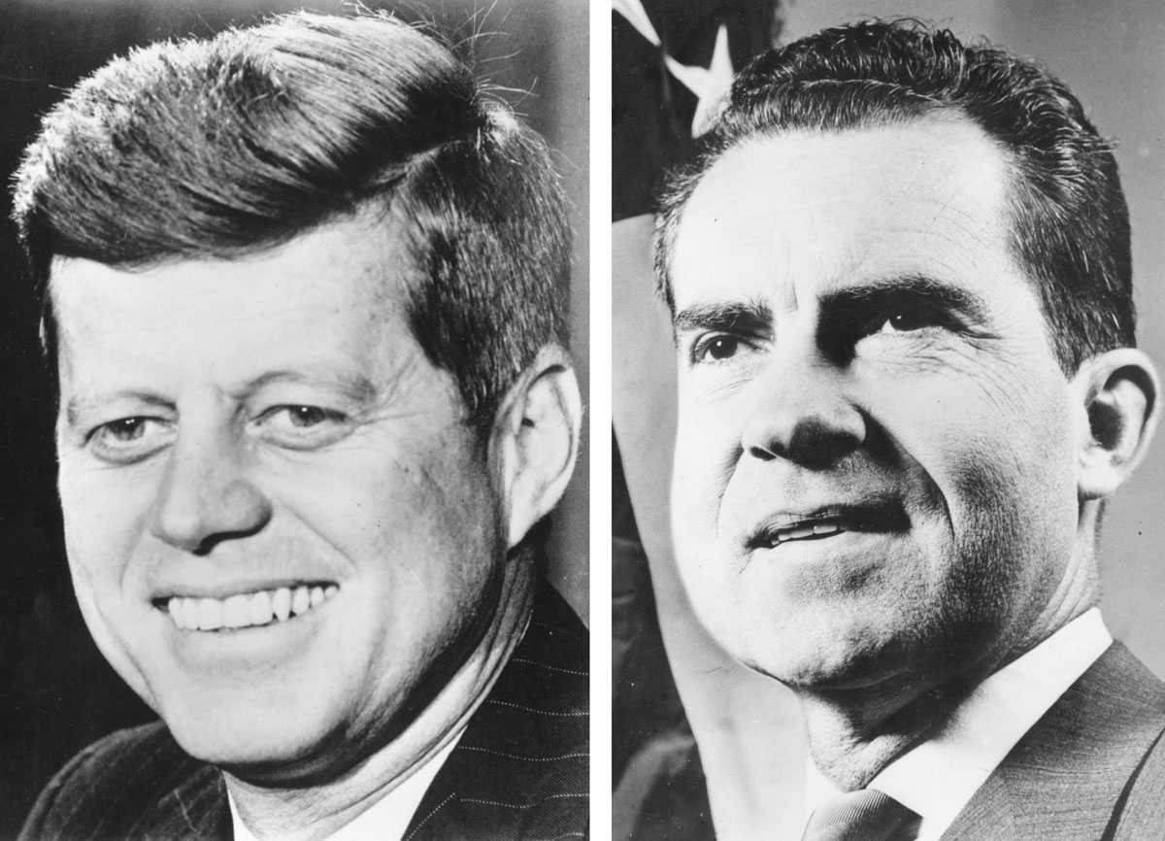
John F. Kennedy Quick Facts:
-Youngest ever US President (44 years old)
- Youngest US President to die
- 4th US President to be killed in office

Slide 30
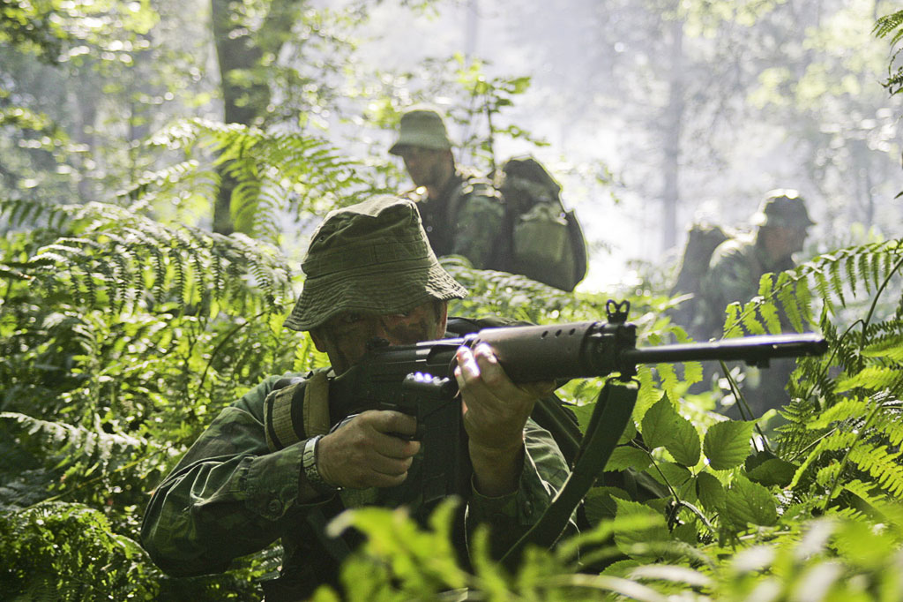
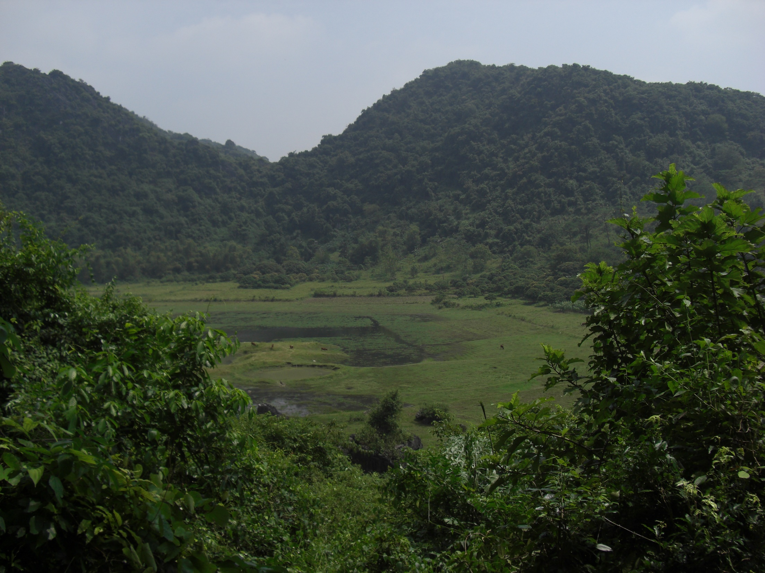
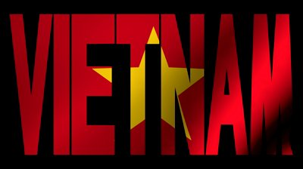
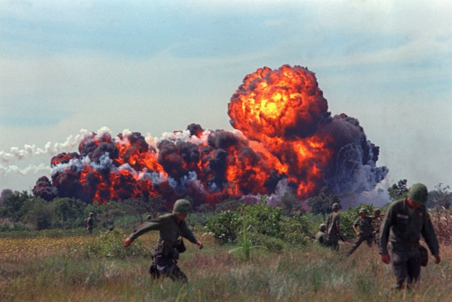
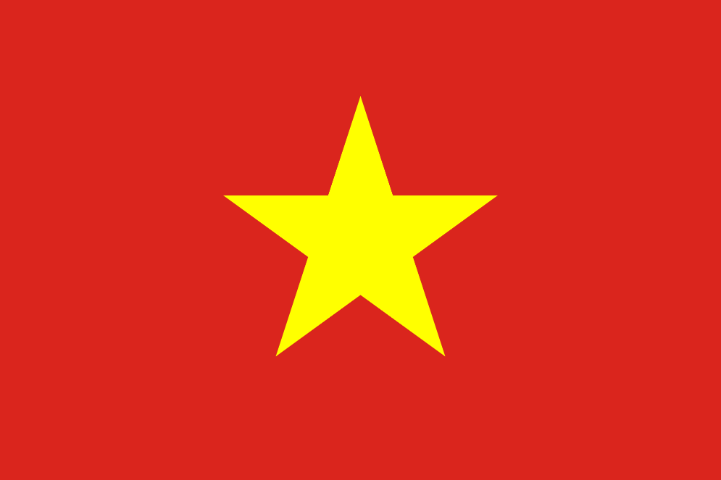

Slide 31
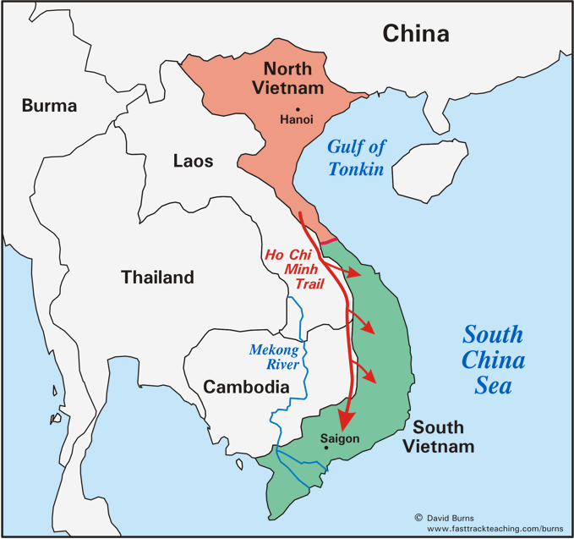
Vietnam War 1954 - 1975
Vietnam was part of the French colony of INDOCHINA that also included Laos and Cambodia

Slide 32
Vietnam War 1954 - 1975
After WW2 the people of Indochina fought against France for freedom.
In 1954 France was defeated in Vietnam by the army of the VIETMINH
Vietnam divided into 2 parts, just like Korea had, a COMMUNIST north and “ANTI COMMUNIST” south.

Slide 33
Vietnam War 1954 - 1975
In 1954 war broke out btwn the North – led by Ho Chi Minh and the South – backed by the United States.
Soon other Communist Countries began to support the North.
The scale of the war was greatly underestimated at the beginning, yet neither side was willing to accept peace.

Slide 34
Vietnam War 1954 - 1975
The war was heavily protested on the home front as casualties piled up and the war debt grew.
By 1969 543,000 US troops were station in Vietnam.
In the final stages of war the US dropped more bombs on North Vietnam than the combined amount of bombs from ALL sides during WW2.

Slide 35
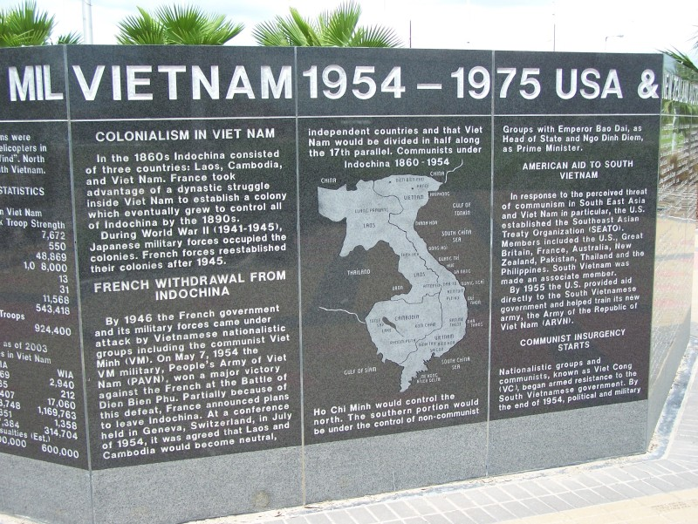
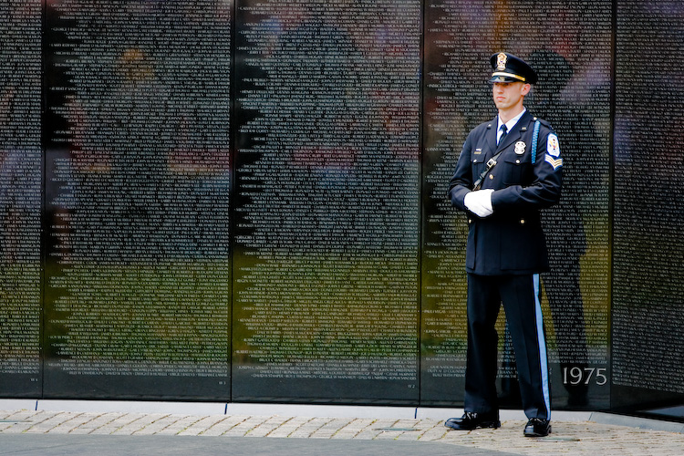
Vietnam War 1954 - 1975
A peace treaty was signed in Paris in 1975 to re-draw the borders at the 18th parallel.
However once the US military left, the north fully invaded the south.

Slide 36
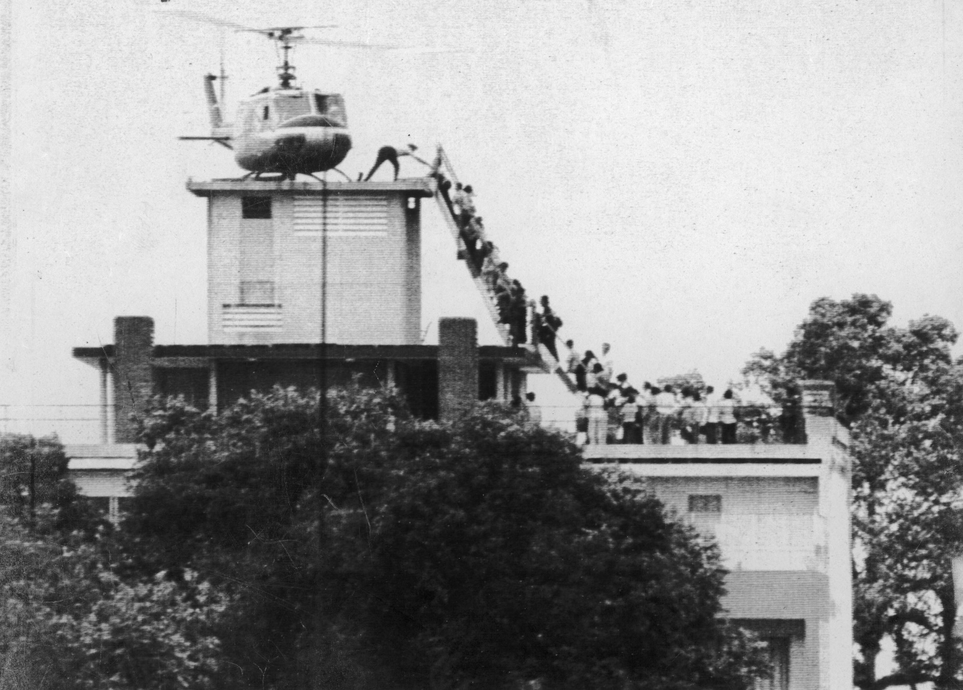
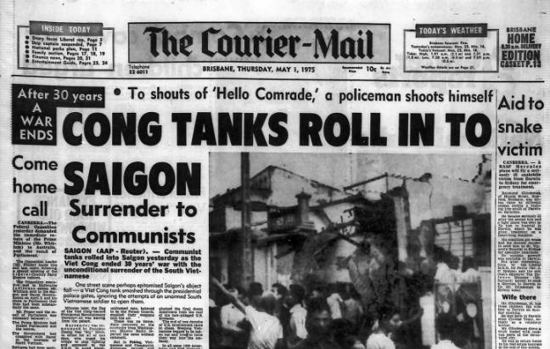

Slide 37
Vietnam War and Canada
Would Canadians in the 1970s have wanted to join the war?
Did Canada send troops?
What were Draft Dodgers?
If you were an American Male aged 18 in 1970 would you be considered a coward for moving to Canada? Would the situation be different if you were 18 in 1954?

